Slide 1
Flu Files
Brion Nono

Slide 2

The Gazette
Montreal, Canada
October 4, 1918
Notes:
I decided to focus on the Montreal Gazette newspaper. I wanted to focus on a different country other than the US to see how they are handled the flu and what they wrote about it. In this screenshot of the article you can see very different kinds of articles on the page, but on the left side it is mainly all articles and news about the spanish influenza.

Slide 3
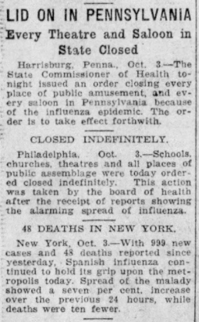
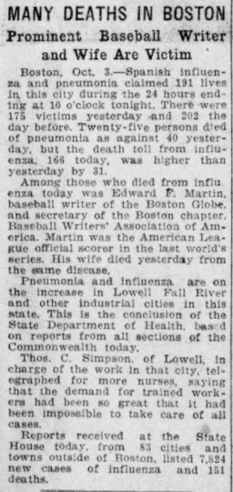
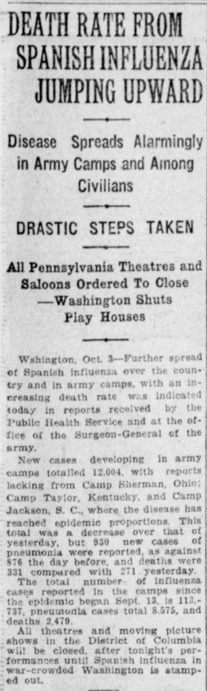
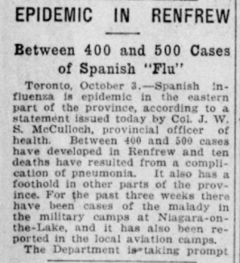
Notes:
These are the articles that are focused on the flu and from what it shows they don't really talk about cities in Canada but mainly about cities in the US. Only one of the articles focus on the flu in Canada.

Slide 4
Epidemic in Renfrew
Between 400 and 500 cases of Spanish “Flu”
Toronto, October 3, -Spanish influenza is epidemic in the eastern part of the province, according to a statement issued today by Col. J. W. S. McCulloch, provincial officer of health. Between 400 and 500 cases have developed in REnfrew and ten deaths have resulted from a complication of pneumonia. It also has a foothold in other parts of the province. For the past three weeks there have been cases of the malady in the military camps at Niagara-on-the-Lake, and it has also been reported in the local aviation camps.
Notes:
Unlike now with 8,82 million cases confirmed and over 200k deaths in America the cases were much lower but there were less people then and it was harder to confirm without the technology. As of now Canada has 223k cases confirmed and 10k deaths. From the article it seems that provinces were taking precautions to the flu and were trying their best to stop it. Back then only 400-500 cases were confirmed during this time in Canada. As well as only 10 deaths confirmed.

Slide 5

The effects of the flu
During this pandemic the country was able to create the Federal Department of Health

Slide 6

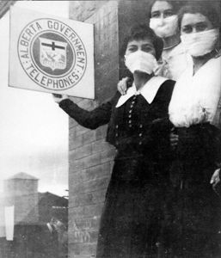

Notes:
Something similar to what we are doing that people have done in the past is that people were wearing some form of a mask to protect themselves from the flu. As i read more into the flu affecting Canada it seems it was very similar to how it is now. Lots of businesses were going out of business due to the pandemic and provinces of the country enforced quarantining to reduce the cases.

Slide 7
Resources
https://search-proquest-com.proxy2.library.illinois.edu/hnpmontrealgazette/pagelevelimagepdf/2150877481/pagelevelImagePDF/DBD03FAE001746E9PQ/1?t:lb=t&accountid=14553
https://thecanadianencyclopedia.ca/en/article/1918-spanish-flu-in-canada

