Slide 1
Covid 19 Journal
By: Drew Kramer
May 31, 2020

Slide 2
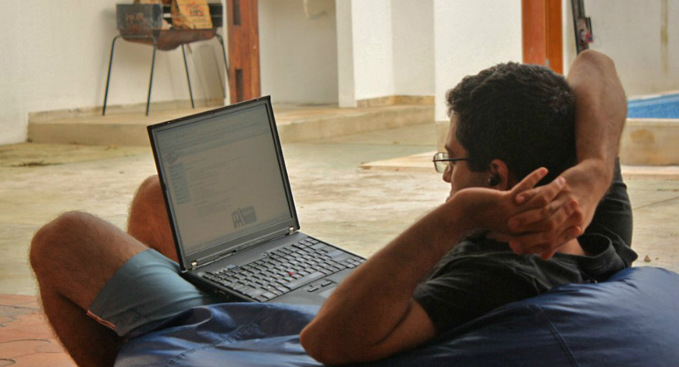
Day to day life
Day to day life has consisted of self-quarantining, meaning my family and I stay indoors most of the day
My parents still work as they are considered by the government ‘essential workers’
Quarantine has given me a lot of time to pursue hobbies I would not have time for and consume entertainment
It can be very dull and draining as I don’t get much sunlight and there is not much to do

Slide 3
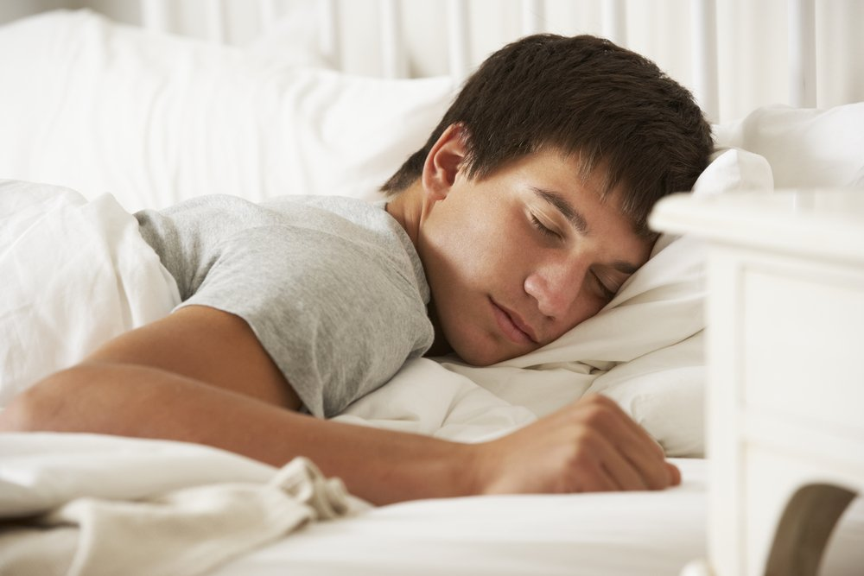
Day to day Life
I find that is it can be mentally exhausting having very small amounts of in person social interaction
I also find myself sleeping at unusual times such as 3am as I do not have to wake up early for school anymore

Slide 4
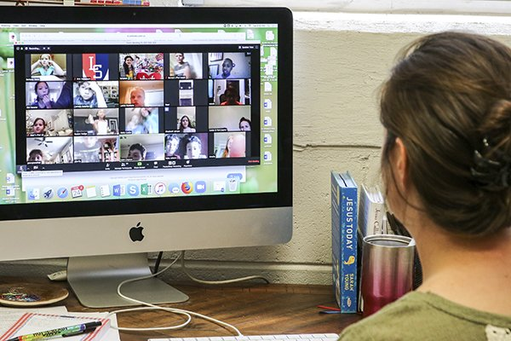
School
School has become completely digital and they call it ‘distance learning’
Personally I do not like this method of teaching as it feels like I am barely learning and all the work feels like busy work
I know it is the best they can do because the outbreak happened so suddenly but it feels like I waste my time doing this work
It is a hard transition from regular school because I feel disconnected from my teachers as they don’t require meetings and hardly talk to us

Slide 5
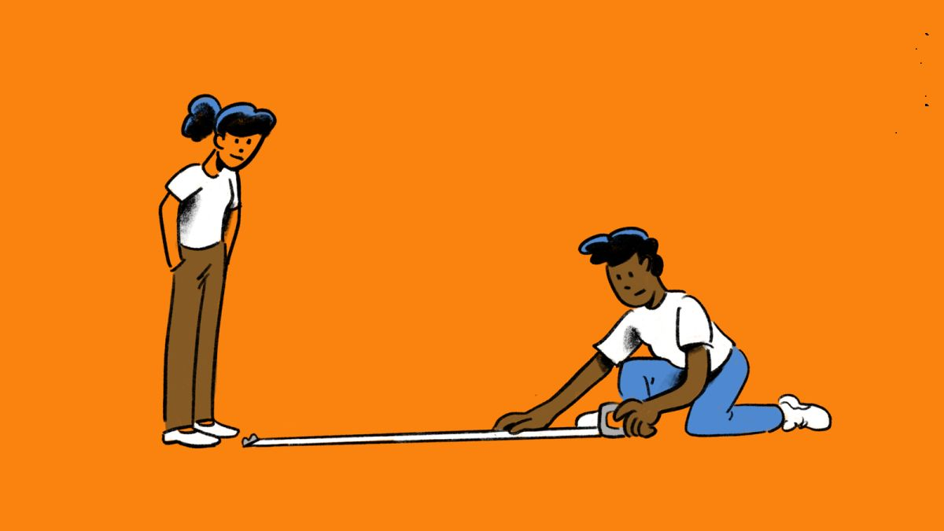
Things That Have Changed
As of right now the general rule for social distancing is to be 6 feet apart from other people
Stores have implemented this into how they operate
Grocery stores will have X markings showing where customers can stand to be a safe distance from others
As of right now it is illegal to have large gatherings of people and if there are gatherings they will be shut down

Slide 6
Covid 19 Journal
By: Drew Kramer
May 31, 2020

Slide 7
Day to day life
Day to day life has consisted of self-quarantining, meaning my family and I stay indoors most of the day
My parents still work as they are considered by the government ‘essential workers’
Quarantine has given me a lot of time to pursue hobbies I would not have time for and consume entertainment
It can be very dull and draining as I don’t get much sunlight and there is not much to do

Slide 8
Day to day Life
I find that is it can be mentally exhausting having very small amounts of in person social interaction
I also find myself sleeping at unusual times such as 3am as I do not have to wake up early for school anymore

Slide 9
School
School has become completely digital and they call it ‘distance learning’
Personally I do not like this method of teaching as it feels like I am barely learning and all the work feels like busy work
I know it is the best they can do because the outbreak happened so suddenly but it feels like I waste my time doing this work
It is a hard transition from regular school because I feel disconnected from my teachers as they don’t require meetings and hardly talk to us

Slide 10
Things That Have Changed
As of right now the general rule for social distancing is to be 6 feet apart from other people
Stores have implemented this into how they operate
Grocery stores will have X markings showing where customers can stand to be a safe distance from others
As of right now it is illegal to have large gatherings of people and if there are gatherings they will be shut down

Slide 11
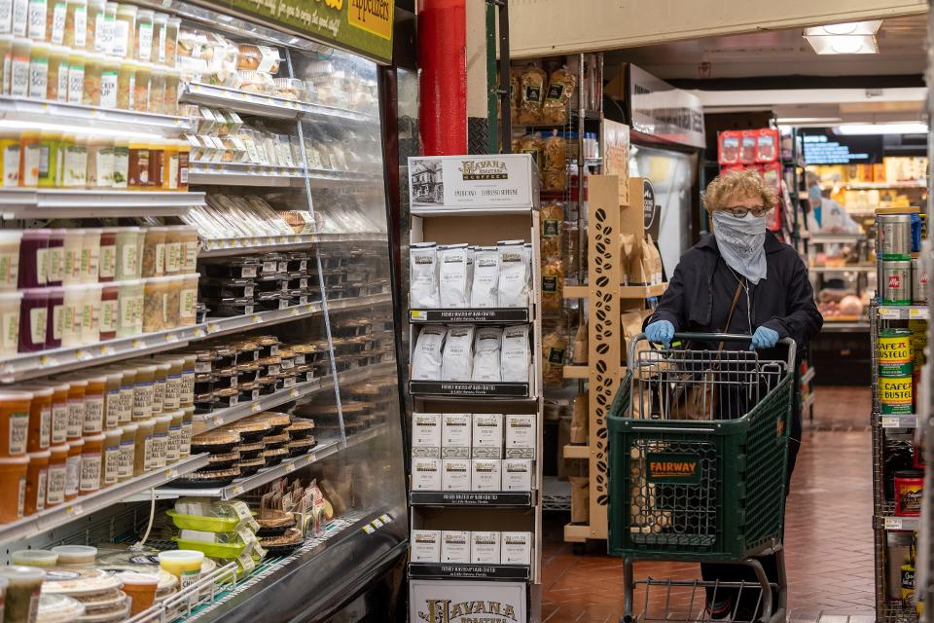
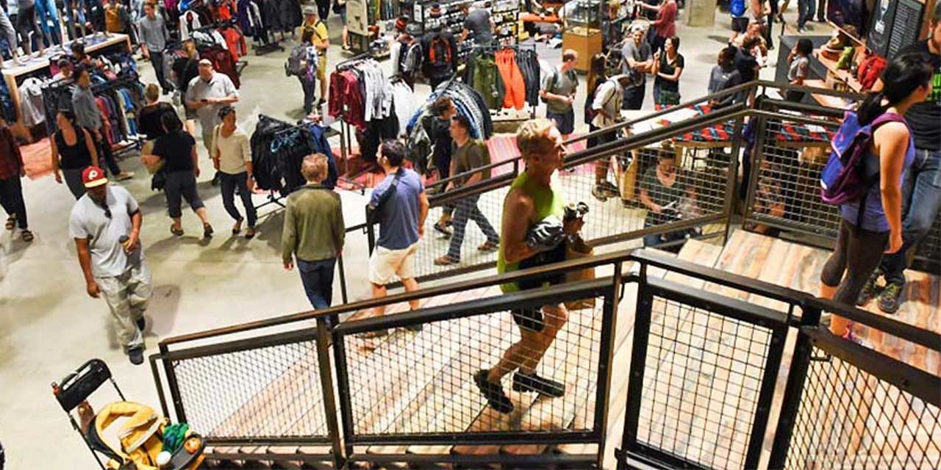
Things That Have Changed
People are required to wear masks when you go outside
Stores require people to wear masks and there is a limit to how many people can be in a store at a time
For a while only grocery stores and government places were open but now as of writing this, businesses are allowed to reopen
Government gives people stimulus checks in order for people without jobs to have some money

Slide 12
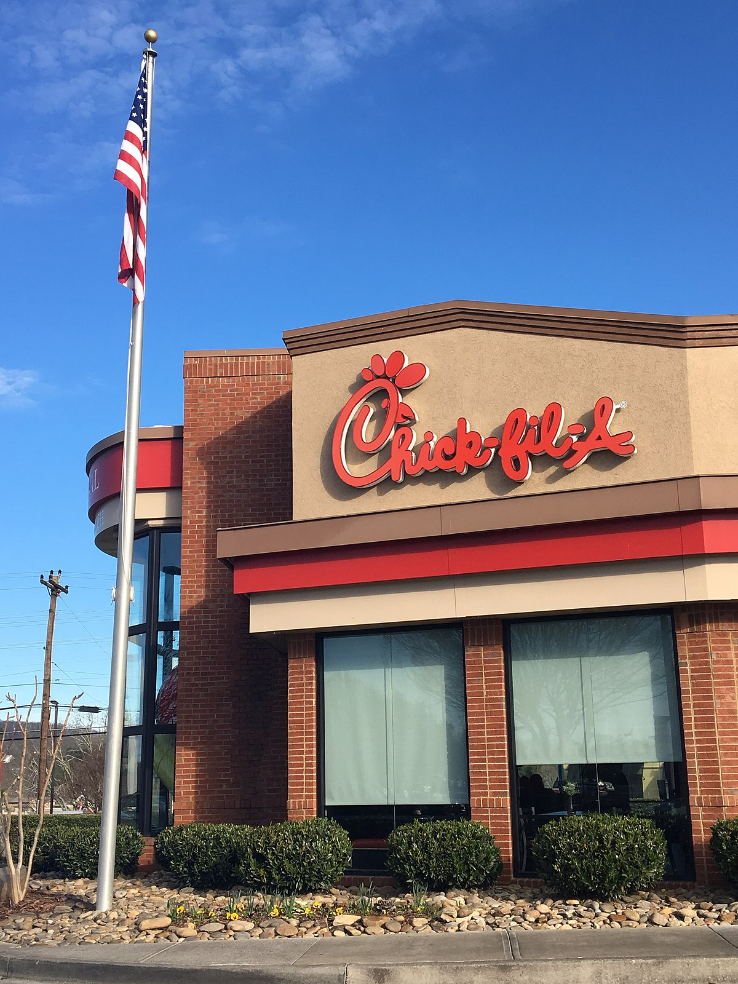
Things That Have Stayed The Same
People are still allowed to go outside
People are allowed to go to drive-in movie theatres
Restaurants are open for takeout and delivery

Slide 13
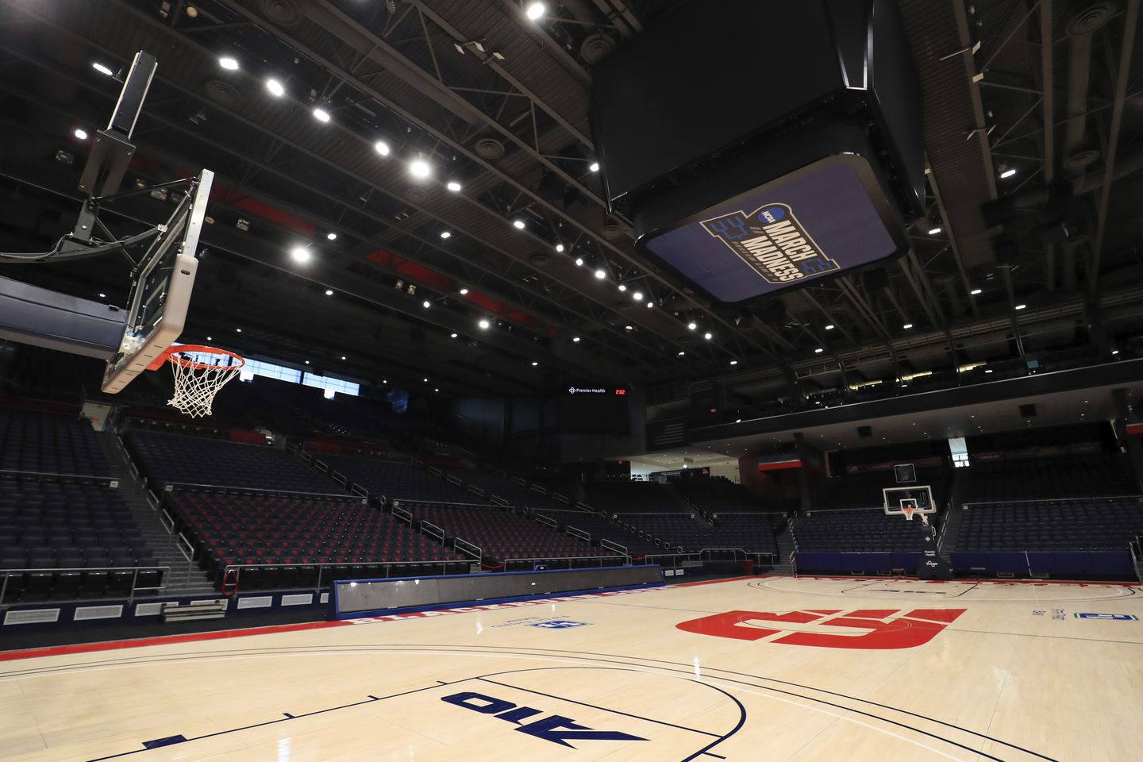
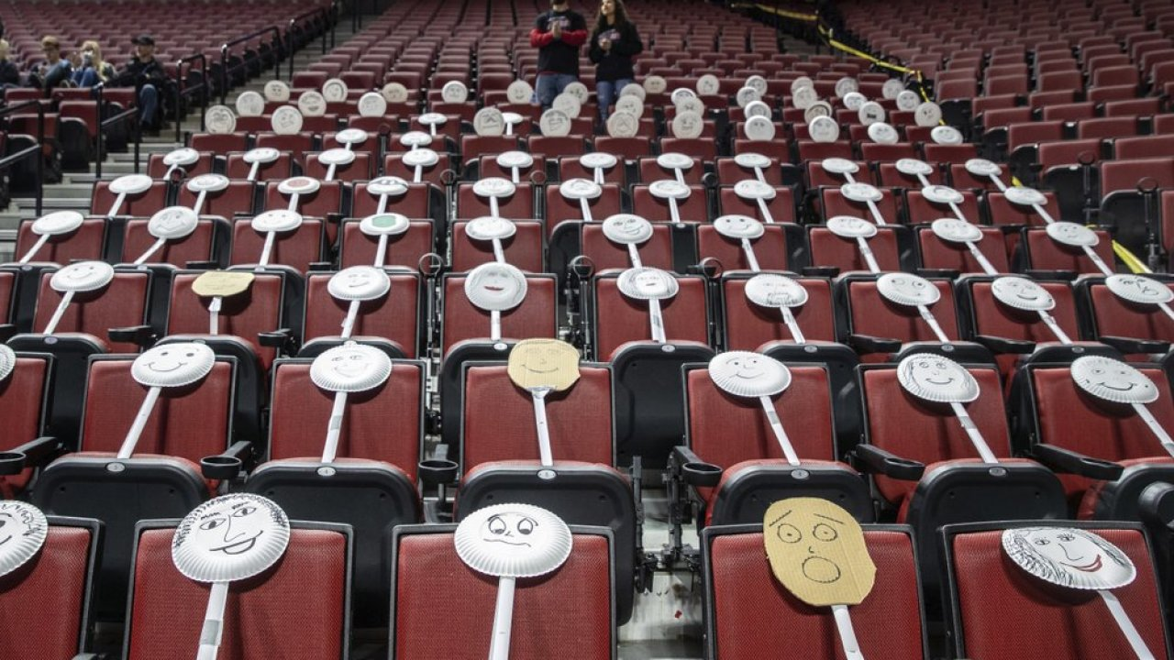
Changes in Entertainment
As of right now all sports seasons are cancelled due to the pandemic
The New York Nets had a Covid situation among the coaches and players in March
Some musicians have turned to livestreaming their concerts in order to make up for not being able to perform
Most shows and movies have delayed in the making or have release dates pushed back

Slide 14
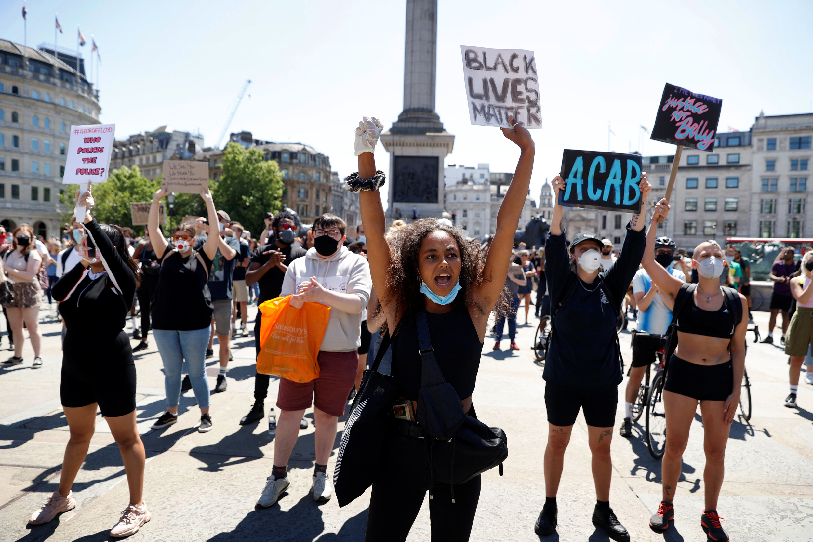
News
There have protests against quarantine with conservative groups carrying assault weapons and flags
There have been 1.83 million cases of Covid with 106k deaths as of May 31
George Floyd protests and riots have caused multiple cities to go into lockdown
  A teenager in Sacramento was shot in the face by a rubber bullet
  A store owner was murdered defending his store
  A couple buildings have been burned down in Minneapolis, Minnesota
  Cities are being looted

Slide 15
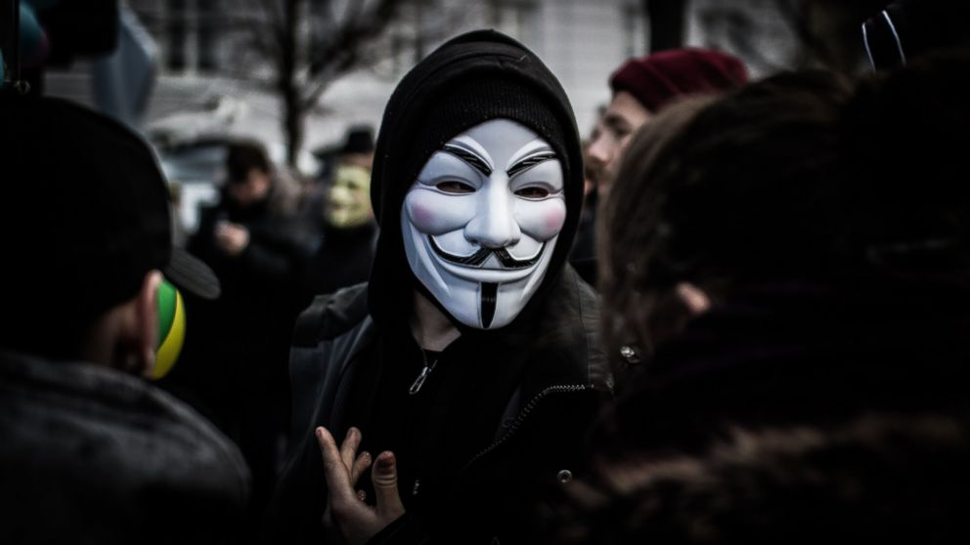
News
Hacktivist group Anonymous have taken down multiple government websites and supposedly leaked information about Trump being apart of Jeffrey Epstein's sex trafficking operation
They also supposedly leaked proof of the British Royal Family killing Princess Diana

Slide 16
Things That Have Changed
People are required to wear masks when you go outside
Stores require people to wear masks and there is a limit to how many people can be in a store at a time
For a while only grocery stores and government places were open but now as of writing this, businesses are allowed to reopen
Government gives people stimulus checks in order for people without jobs to have some money

Slide 17
Things That Have Stayed The Same
People are still allowed to go outside
People are allowed to go to drive-in movie theatres
Restaurants are open for takeout and delivery

Slide 18
Changes in Entertainment
As of right now all sports seasons are cancelled due to the pandemic
The New York Nets had a Covid situation among the coaches and players in March
Some musicians have turned to livestreaming their concerts in order to make up for not being able to perform
Most shows and movies have delayed in the making or have release dates pushed back

Slide 19
News
There have protests against quarantine with conservative groups carrying assault weapons and flags
There have been 1.83 million cases of Covid with 106k deaths as of May 31
George Floyd protests and riots have caused multiple cities to go into lockdown
  A teenager in Sacramento was shot in the face by a rubber bullet
  A store owner was murdered defending his store
  A couple buildings have been burned down in Minneapolis, Minnesota
  Cities are being looted

Slide 20
News
Hacktivist group Anonymous have taken down multiple government websites and supposedly leaked information about Trump being apart of Jeffrey Epstein's sex trafficking operation
They also supposedly leaked proof of the British Royal Family killing Princess Diana

