Slide 1
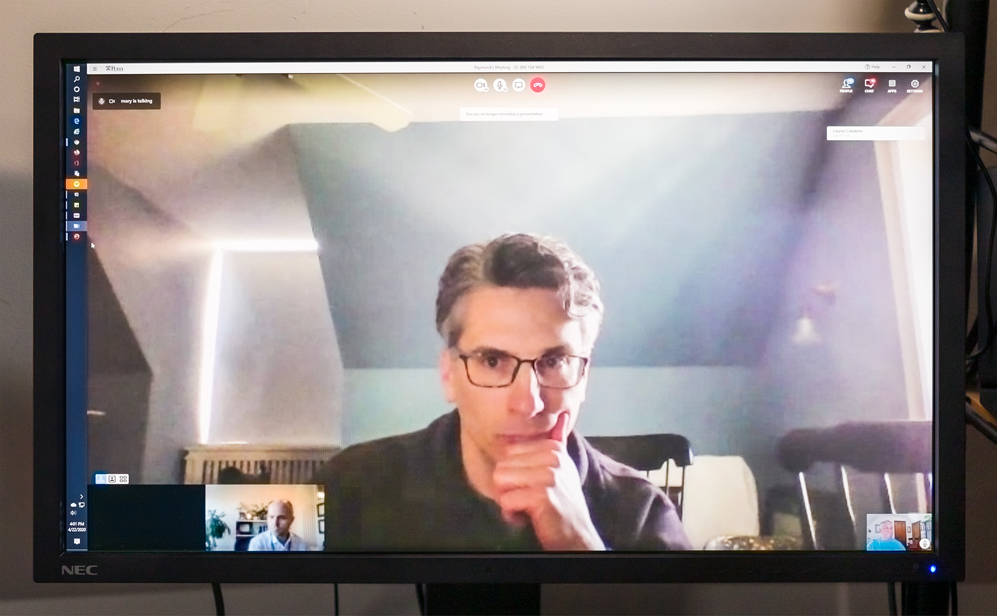
Medical Intensivists (COVID-19)
DRAFT
Not for Distribution
John Hansen-Flaschen, M.D.

Slide 2
In mid-March 2020, medical intensive care physicians at the downtown Philadelphia hospitals of the University of Pennsylvania were called abruptly from career and family life to confront an unforeseen, lethal threat of unknowable magnitude and duration. Early predictive models anticipated a catastrophic crush of COVID-19 ICU admissions to Penn Medicine hospitals. Together with nurses, therapists, chaplains and others, the intensivists filled a rapidly expanding schedule of 12-hour day and night ICU work shifts recurring for weeks as often as half on, half off.
I stayed home. Because of the heightened risk to people my age, I was no longer welcome in the ICU that has long felt like my second home. I found another way to engage. For the first time, most Penn Medicine meetings devoted to emergency preparedness and coordination of intensive care took place online by video teleconferencing. Fifteen-minute huddles focused on immediate front-line challenges. Out of longer meetings poured hundreds of pages of staffing schedules, policies, procedure manuals, communication guides, and continuously updated educational content. I worked with a team devoted to procuring mechanical ventilators, and I watched and photographed colleagues as they appeared during innumerable meetings on my home computer monitor.
These photographs show physicians conferring with one another from home kitchen tables, bedrooms and sunrooms, hotel rooms, and quieter corners of open hospital spaces. First-growth beards, newly shaved heads, grey hair roots and unruly curls testify to regular lives interrupted. The variable quality of the images captured under casual light by laptop, tablet or cell phone cameras and transmitted across overburdened networks is typical of how we saw one another online.
In these photographic portraits of friends and colleagues, I see the vulnerability that invariably accompanies mastery. I see fortitude, the strength of mind and moral sense of duty that enable well-prepared people to encounter danger with courage and grace. Most of all, I see a kind of beautiful that emerges when people work unselfconsciously to exhaustion against an emergent, unanticipated adversity that threatens all.

Slide 3
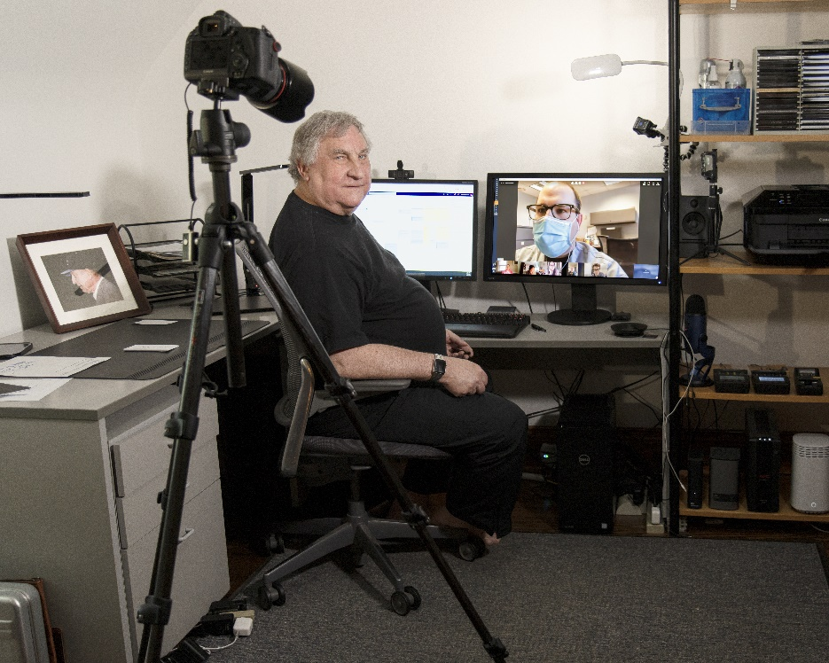
John Hansen-Flaschen is a physician and photographer. After joining the faculty at the University of Pennsylvania in Philadelphia as a pulmonary and critical care physician in 1981, he rose through the academic ranks to become an endowed Professor of Medicine while continuing to care for critically ill inpatients and for outpatients with lung diseases at the Hospital of the University of Pennsylvania. Dr. Hansen-Flaschen founded the Paul Harron Lung Center and he served for 25 years as Chief of the Pulmonary, Allergy and Critical Care Division, both at Penn. He continues to see outpatients and teach part-time.
Dr. Hansen-Flaschen’s photographic work explores ordinary and extraordinary life experiences in a narrow corridor of land that extends from his family home in a Western suburb of Philadelphia to the inner-city hospital sites where he works. One major project engaged people he encountered on his daily commute along Lancaster Avenue through West Philadelphia. Other works seek unexpected beauty in the personal crises that draw together critically ill patients, their loved ones, and the clinicians who try to rescue them within the confines of the medical intensive care unit at the hospital he has served for more than 40 years.

Slide 4
Details
Academic Title and Contact Information
John Hansen-Flaschen MD
Paul F. Harron Jr. Family Emeritus Professor of Medicine
Perelman School of Medicine, University of Pennsylvania
jflash@uphs.upenn.edu
Mobile: 610 896 9042
Work: 615 662 5371
Administrative Assistant: Nancy Fedullo
nancy.fedullo@pennmedicine.upenn.edu
Notes
Photographic release forms have been signed by all subjects included in this portrait collection and are available on request.
Four full size tiff files demonstrating the range of image quality in the project photographs can be accessed here: https://spaces.hightail.com/space/46GuImZfpG
All content in this document is copyright owned by John Hansen-Flaschen. Except as permitted by the applicable copyright law, none of the content may be reproduced or distributed electronically without written permission of the copyright owner.

Slide 5
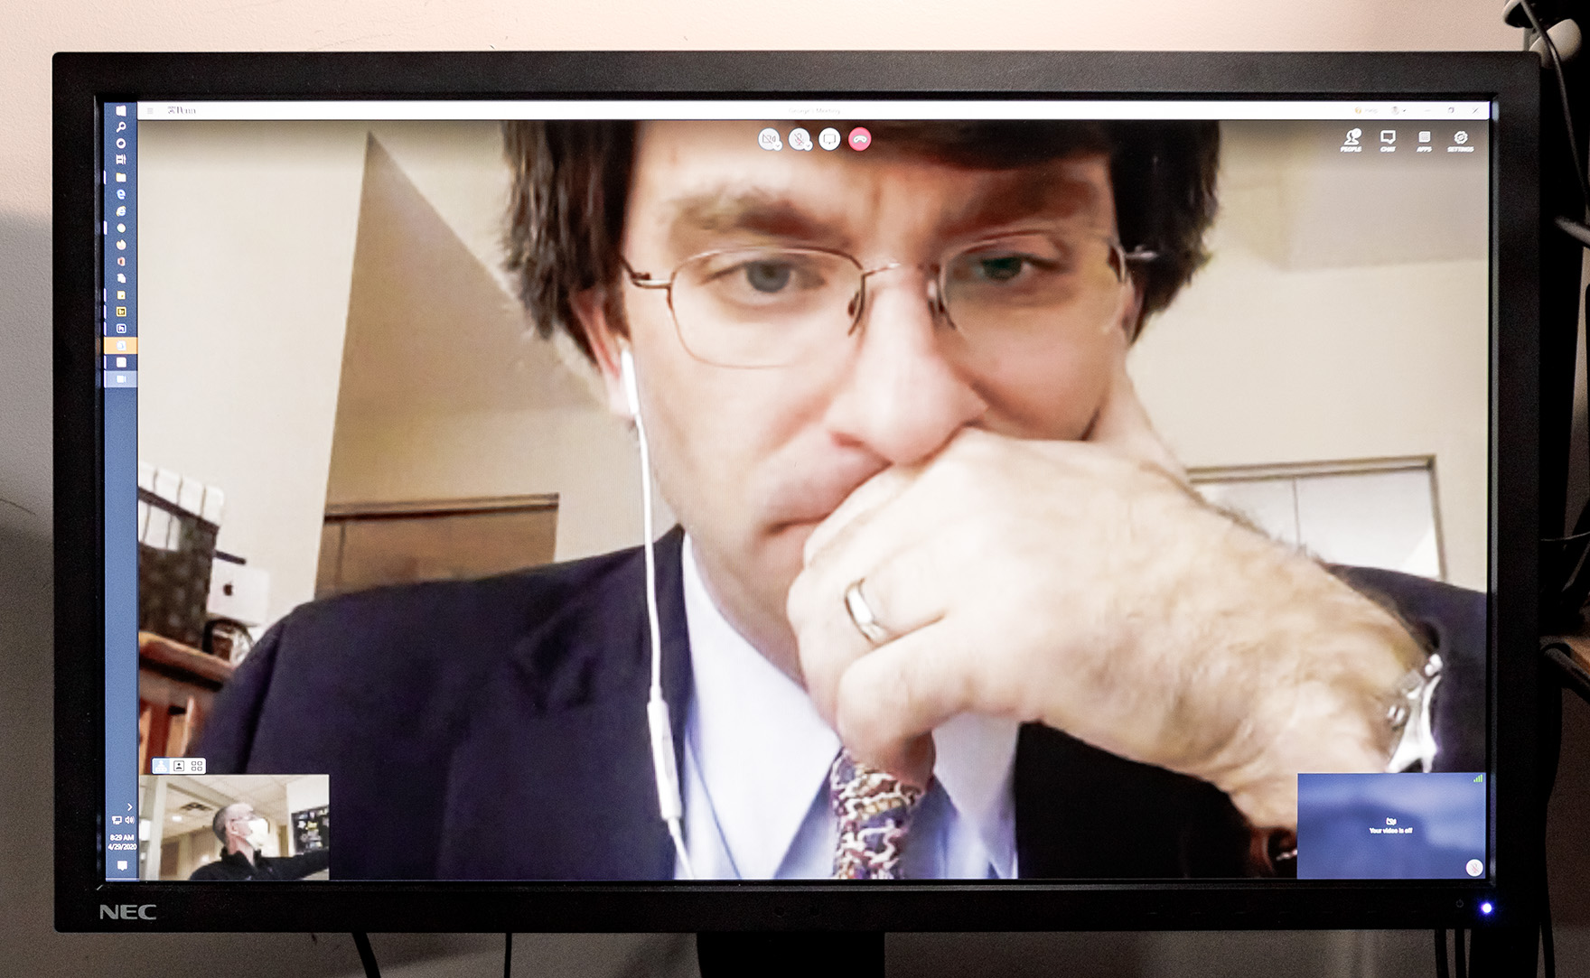
George Anesi
Chair, Penn Medicine Critical Care Alliance Pandemic Preparedness Committee
Medical Intensivist, Hospital of the University of Pennsylvania

Slide 6
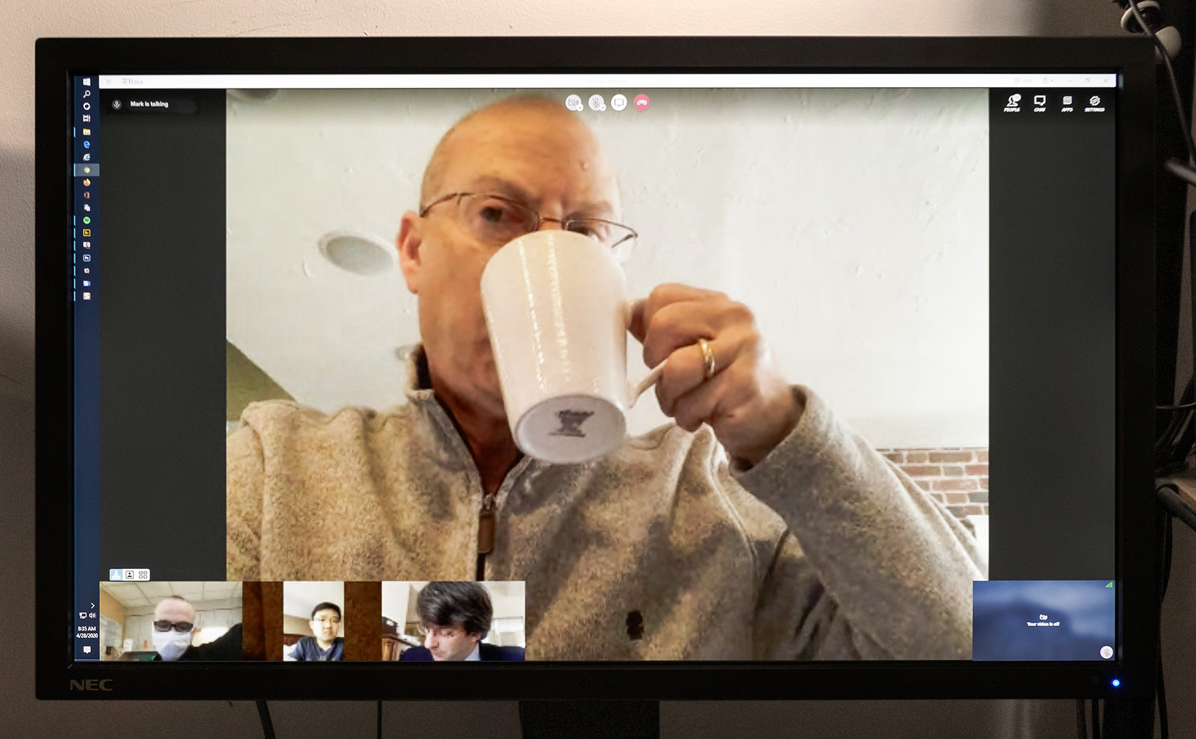
Barry Fuchs
Head, Ventilator Emergency Procurement Committee
Medical Director, Medical Critical Care Unit and Respiratory Care Department,
Hospital of the University of Pennsylvania

Slide 7
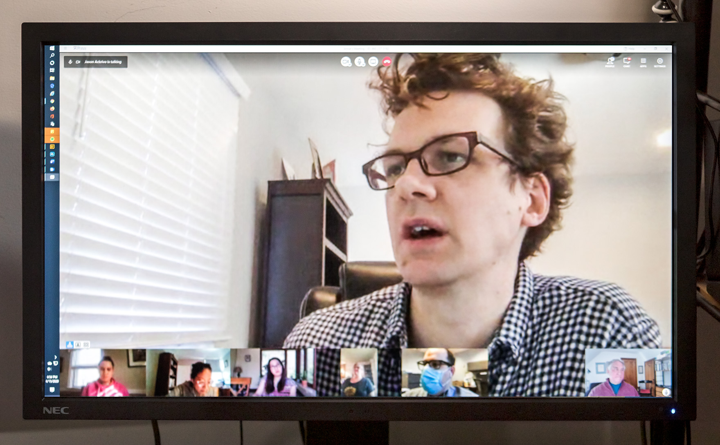
Jason Ackrivo
Ventilator Emergency Procurement Committee
Medical Intensivist, Hospital of the University of Pennsylvania

Slide 8
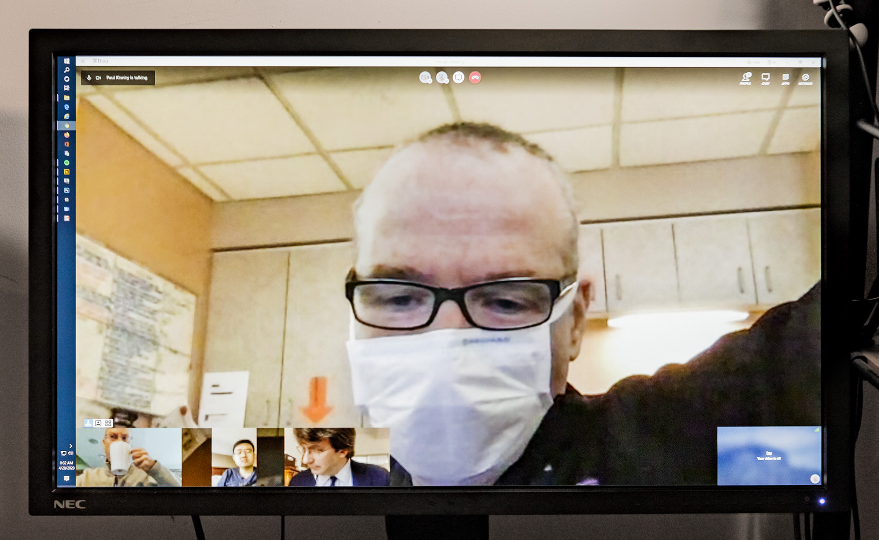
Paul Kinniry
Medical Director, Medical Intensive Care Unit, Pennsylvania Hospital

Slide 9
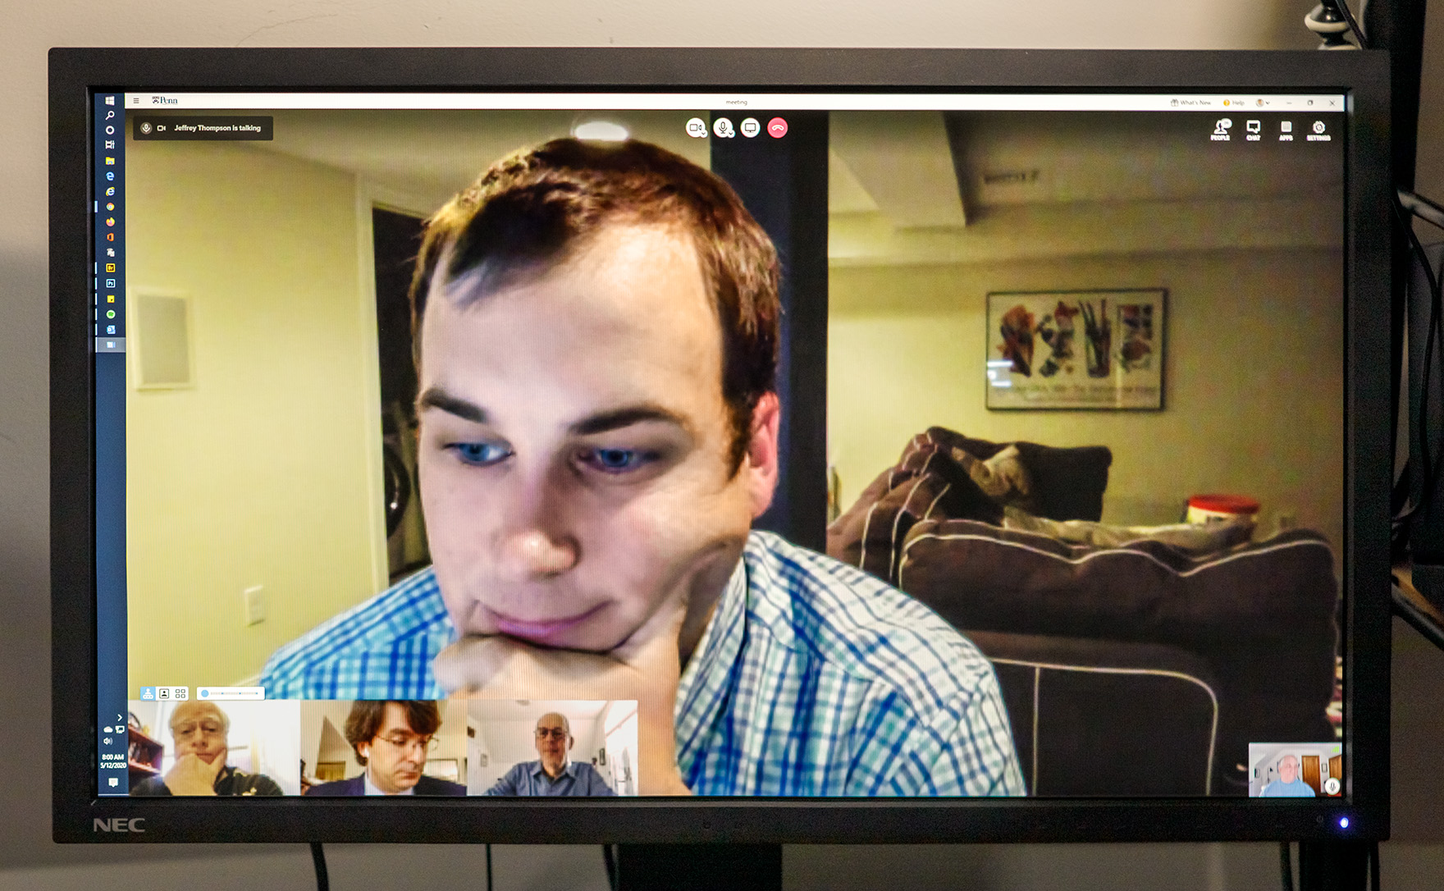
Jeffrey Thompson
Medical intensivist, Hospital of the University of Pennsylvania

Slide 10
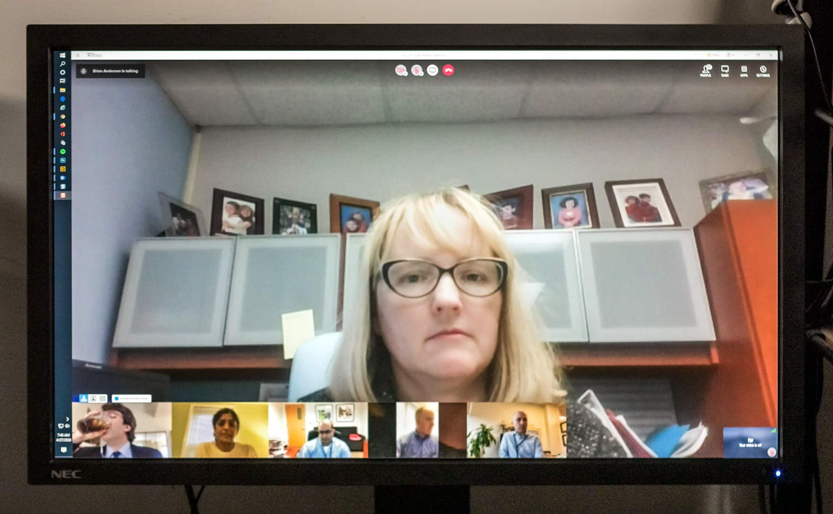
Maryl Kreider
Coordinator, Inpatient Service Scheduling during the COVID-19 crisis
Medical Intensivist, Hospital of the University of Pennsylvania

Slide 11
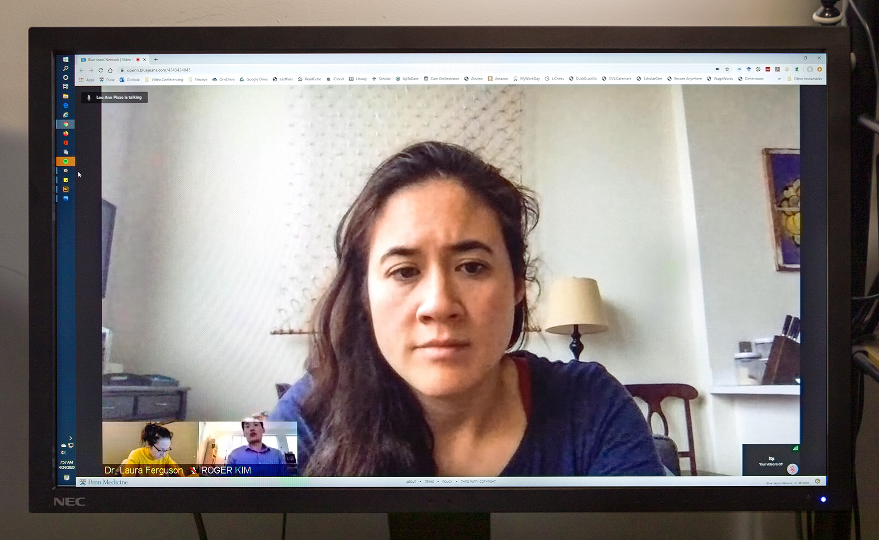
Jessica Lee
Pulmonary and Critical Care Fellow

Slide 12
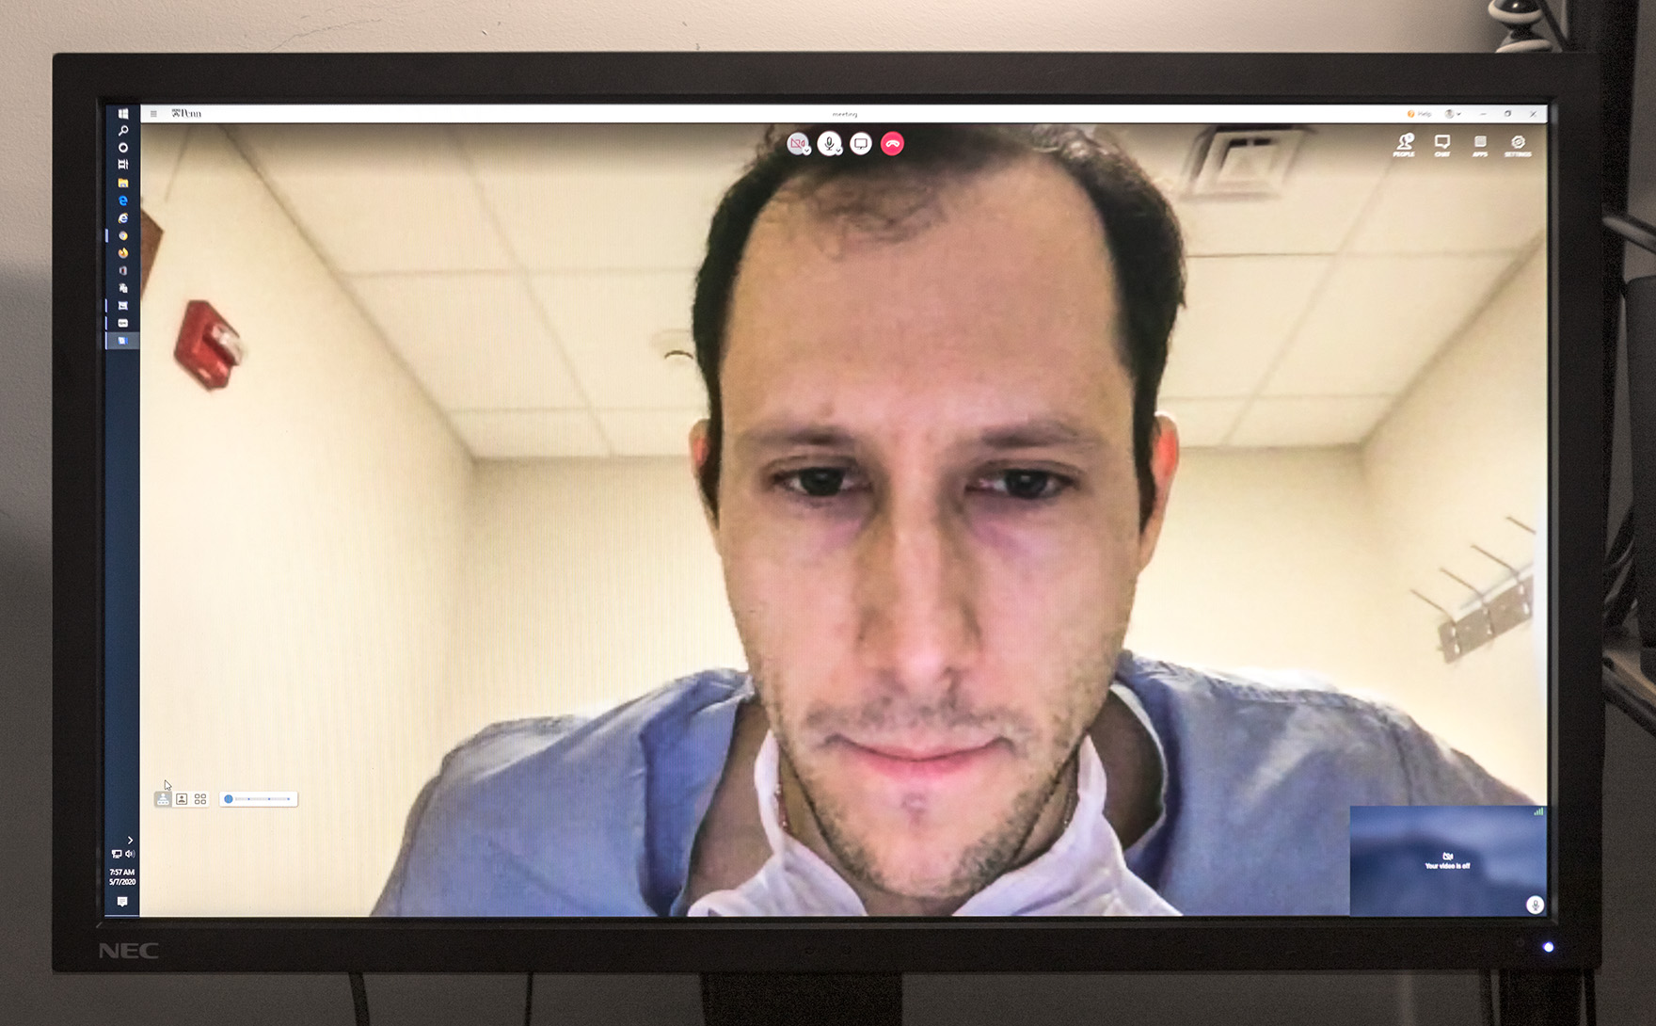
Peter Planer
Pulmonary and Critical Care Fellow

Slide 13
Andrew Haas
Covid-19 Tracheostomy Task Force
Medical Intensivist, Hospital of the University of Pennsylvania

Slide 14
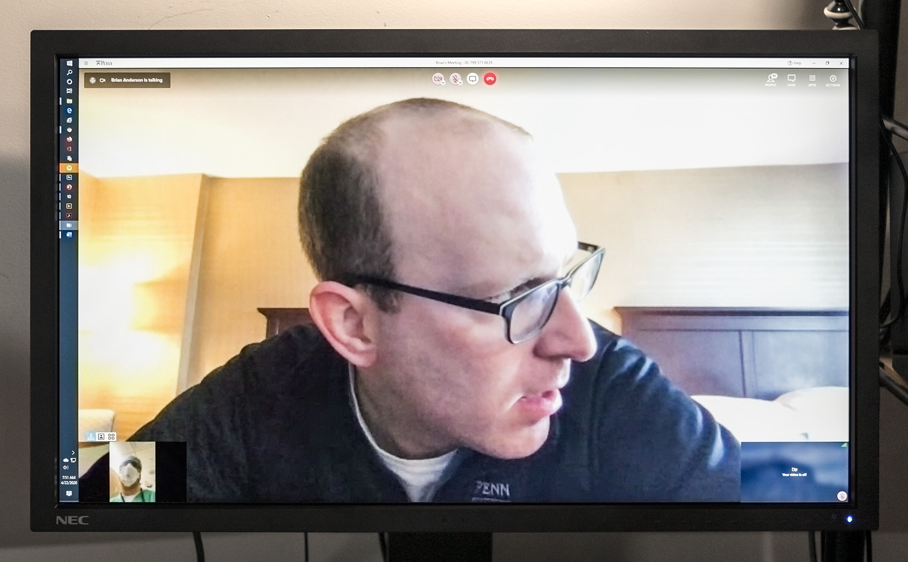
Brian Anderson
Coordinator, COVID Daily Safety Calls
Associate Medical Director, Medical Intensive Care Unit, Hospital of the University of Pennsylvania

Slide 15
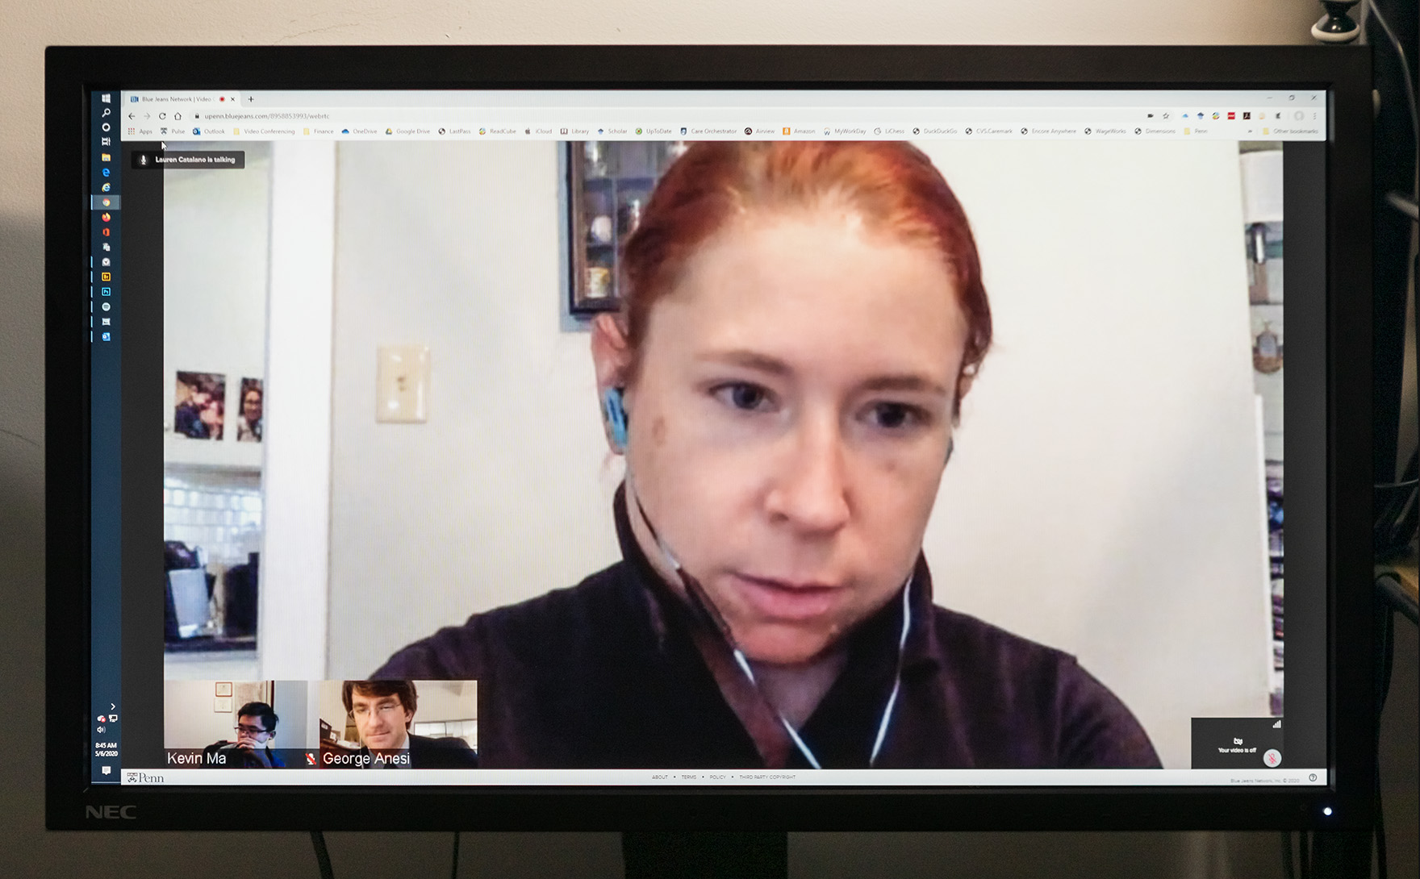
Lauren Catalano
Medical Intensivist, Pennsylvania Hospital

Slide 16
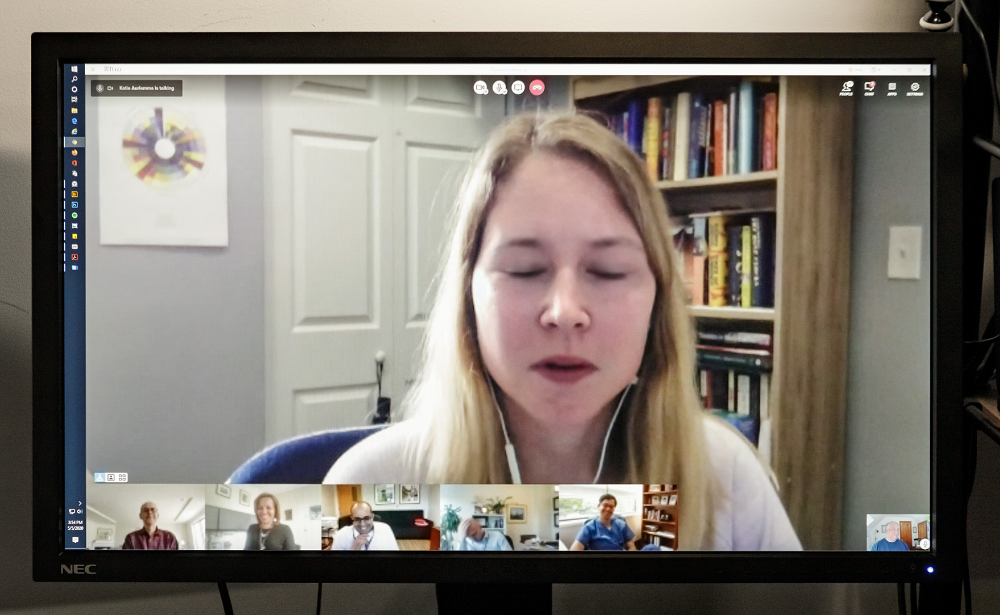
Katharine Auriemma
Pulmonary and Critical Care Fellow

Slide 17
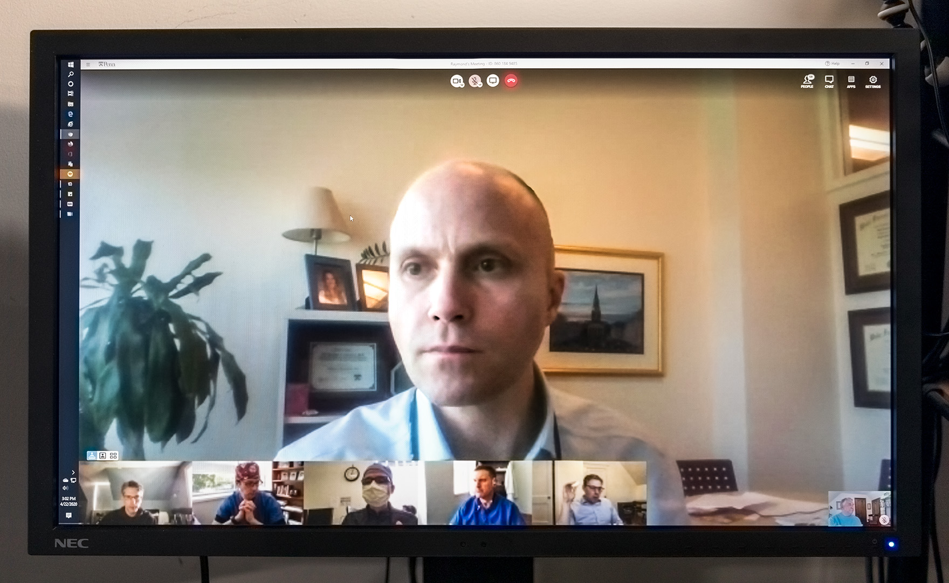
William Schweickert
Vice Chair, Quality and Safety, Department of Medicine
Medical Intensivist, Hospital of the University of Pennsylvania

Slide 18
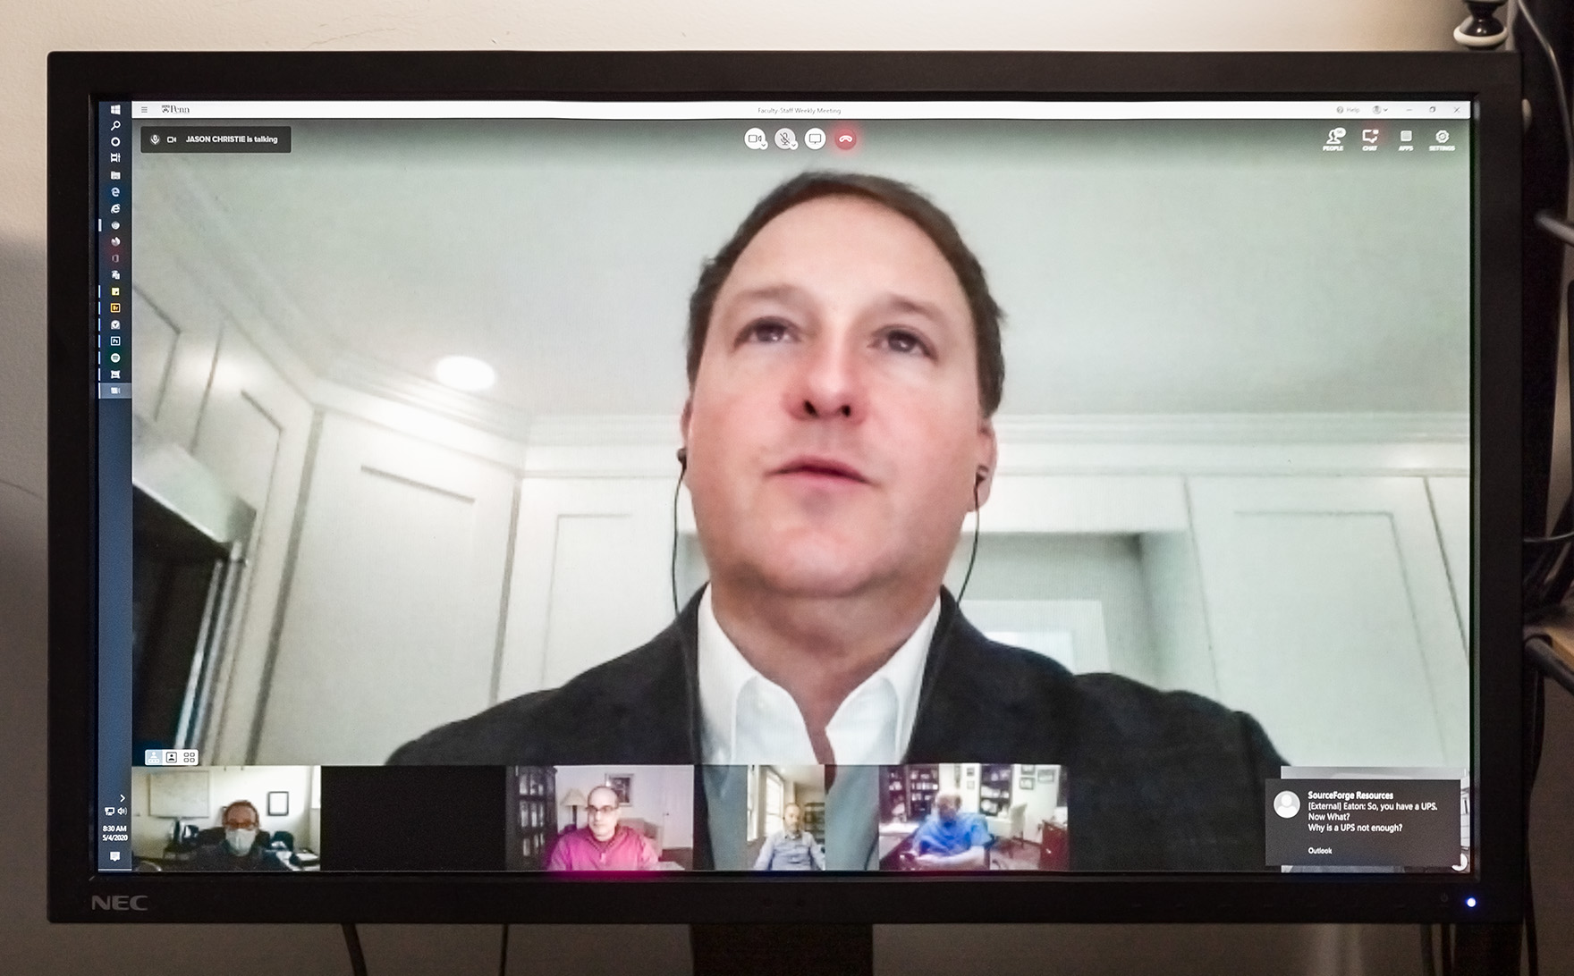
Jason Christie
Chief, Pulmonary, Allergy, and Critical Care Division
Medical Intensivist, Hospital of the University of Pennsylvania

Slide 19
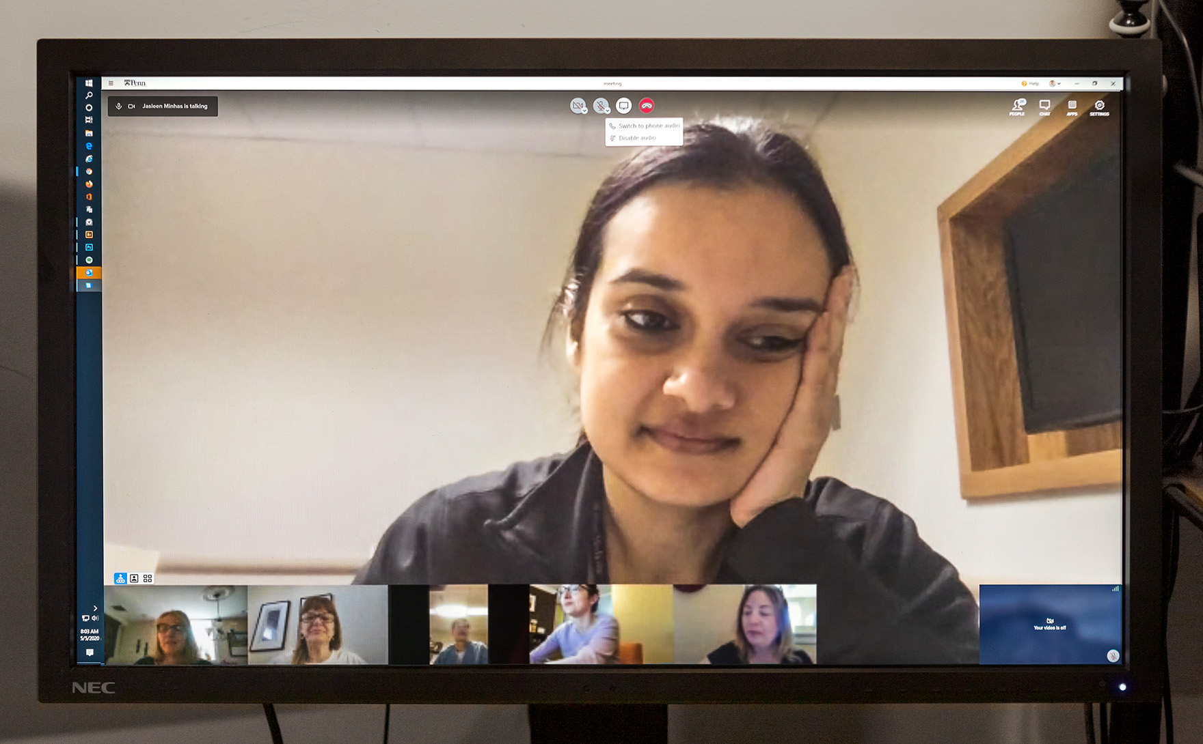
Jasleen Minhas
Pulmonary and Critical Care Fellow

Slide 20
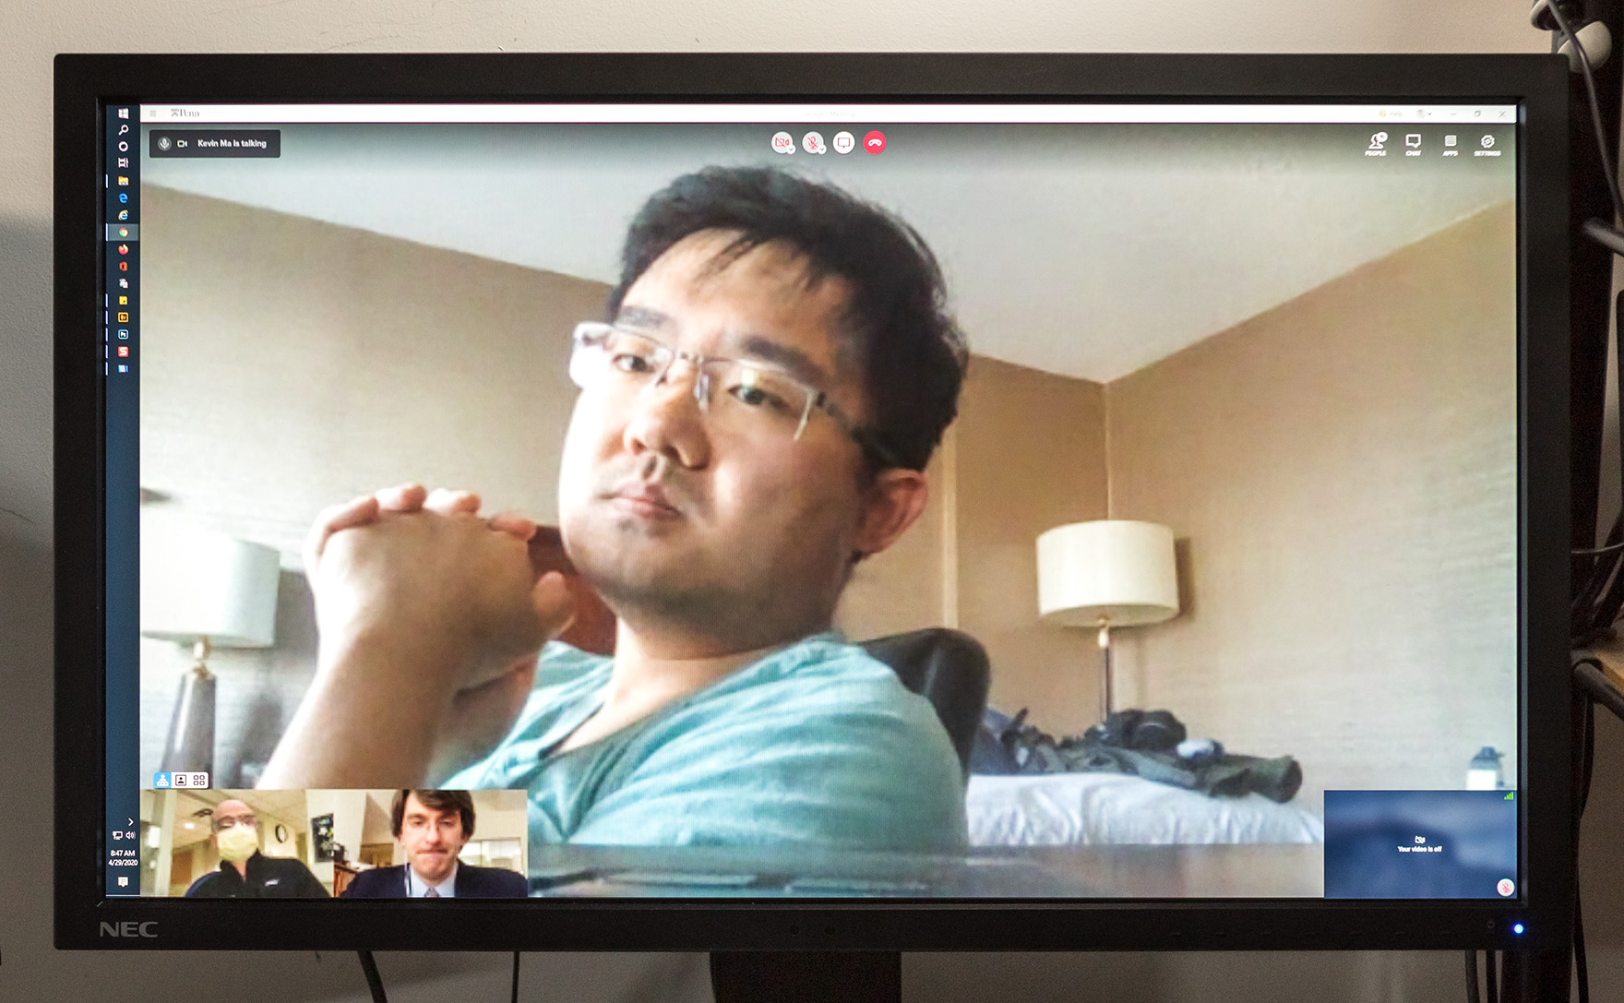
Kevin Ma
Medical Director, Clinical Emergencies Task Force, Penn Presbyterian Medical Center
Medical Intensivist, Penn Presbyterian Medical Center

Slide 21
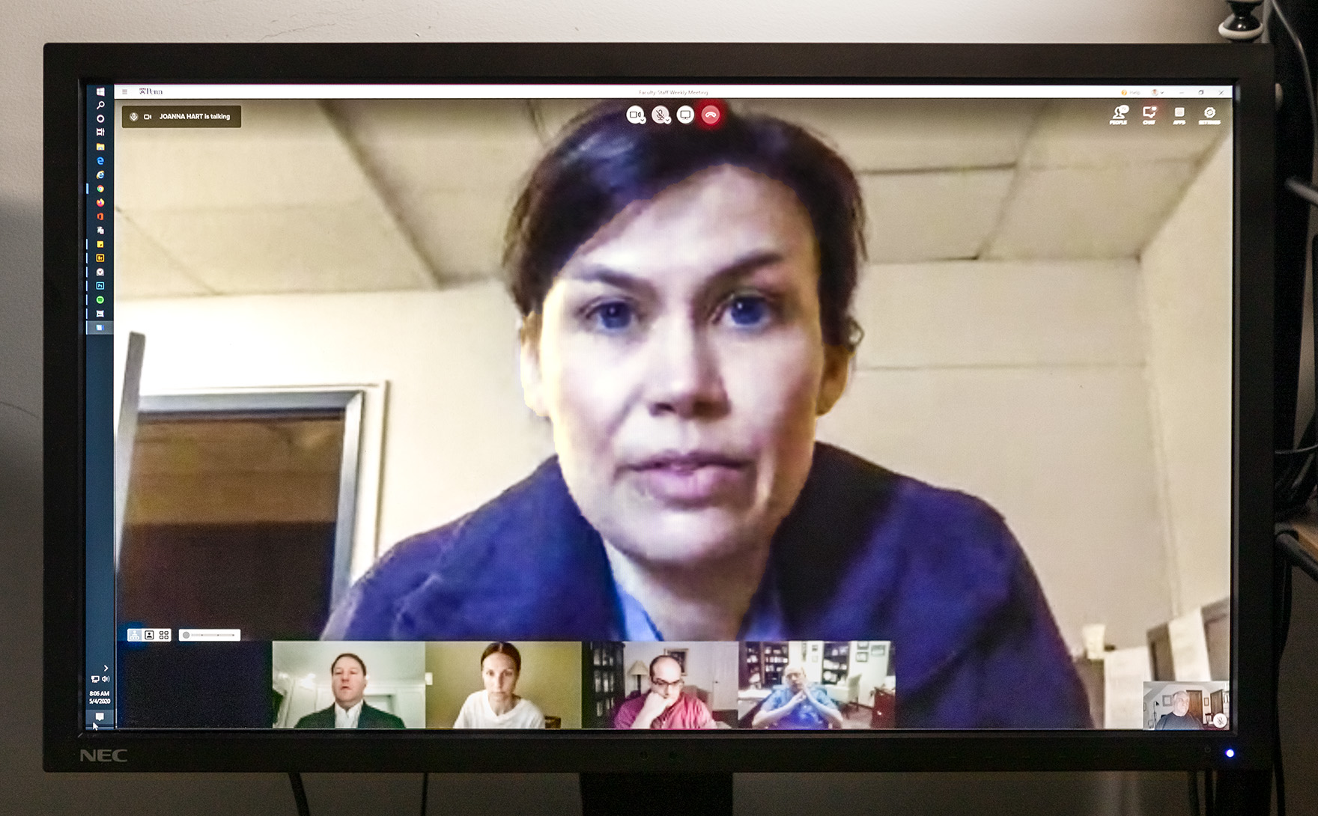
Joanna Hart
Leader, ad hoc Committee on Family ICU Visitation during the COVID crisis
Medical Intensivist, Hospital of the University of Pennsylvania

Slide 22
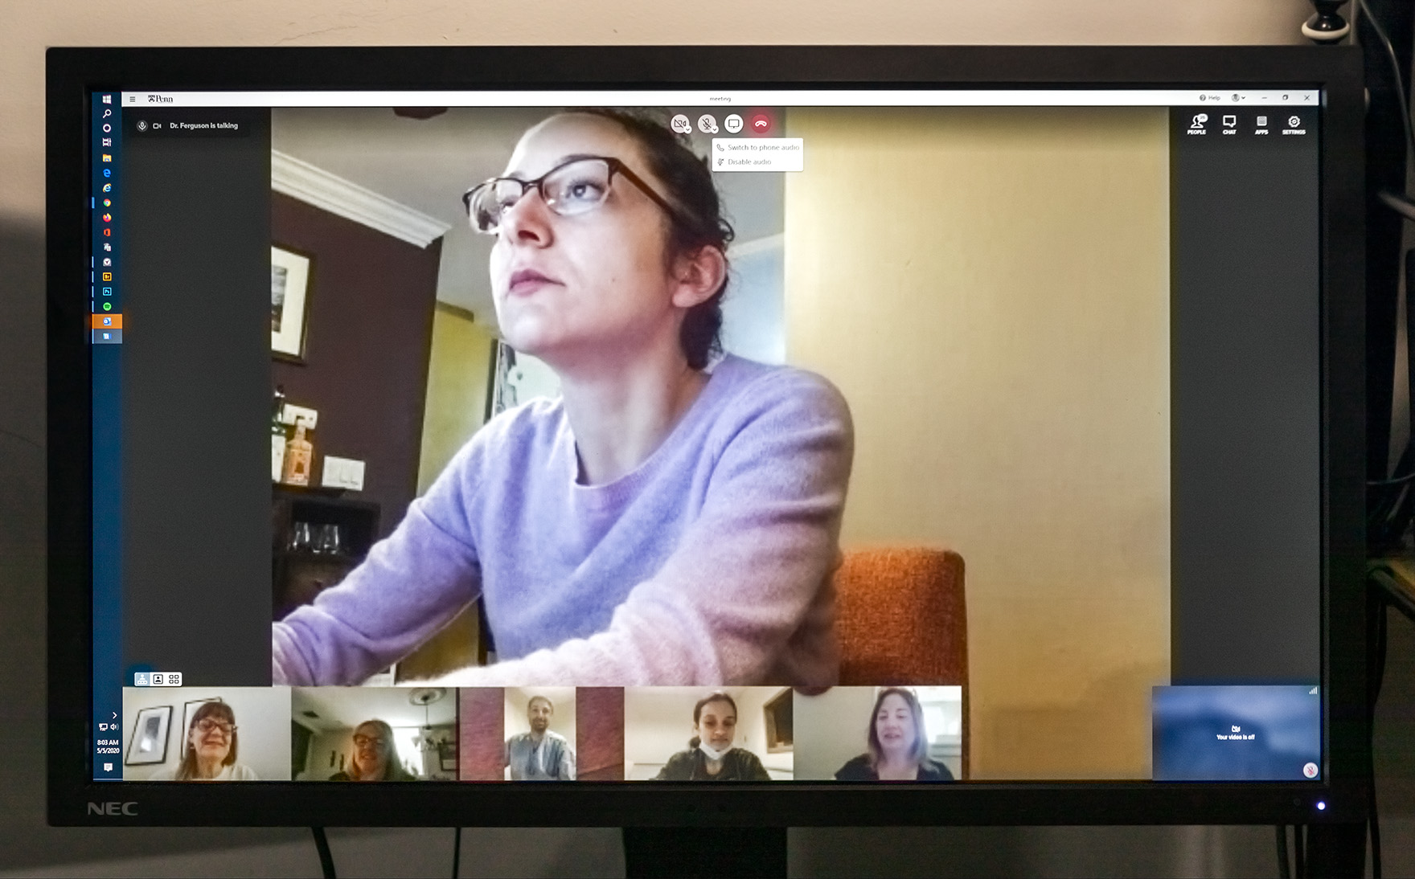
Laura Ferguson
Pulmonary and Critical Care Fellow

Slide 23
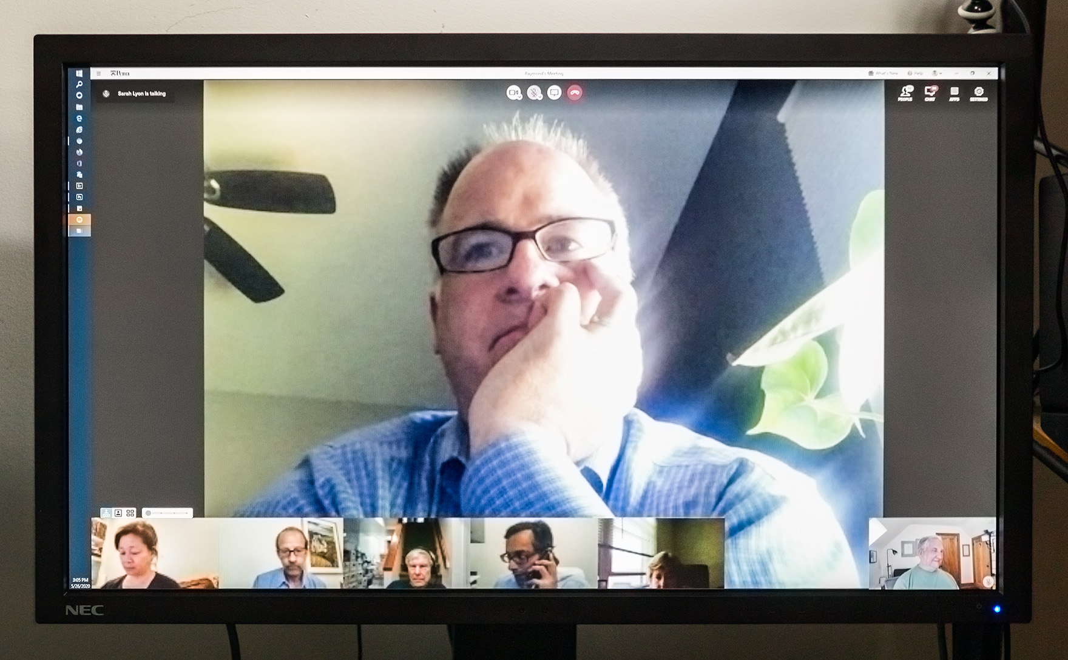
Michael Sims
Medical intensivist, Penn Presbyterian Medical Center

Slide 24
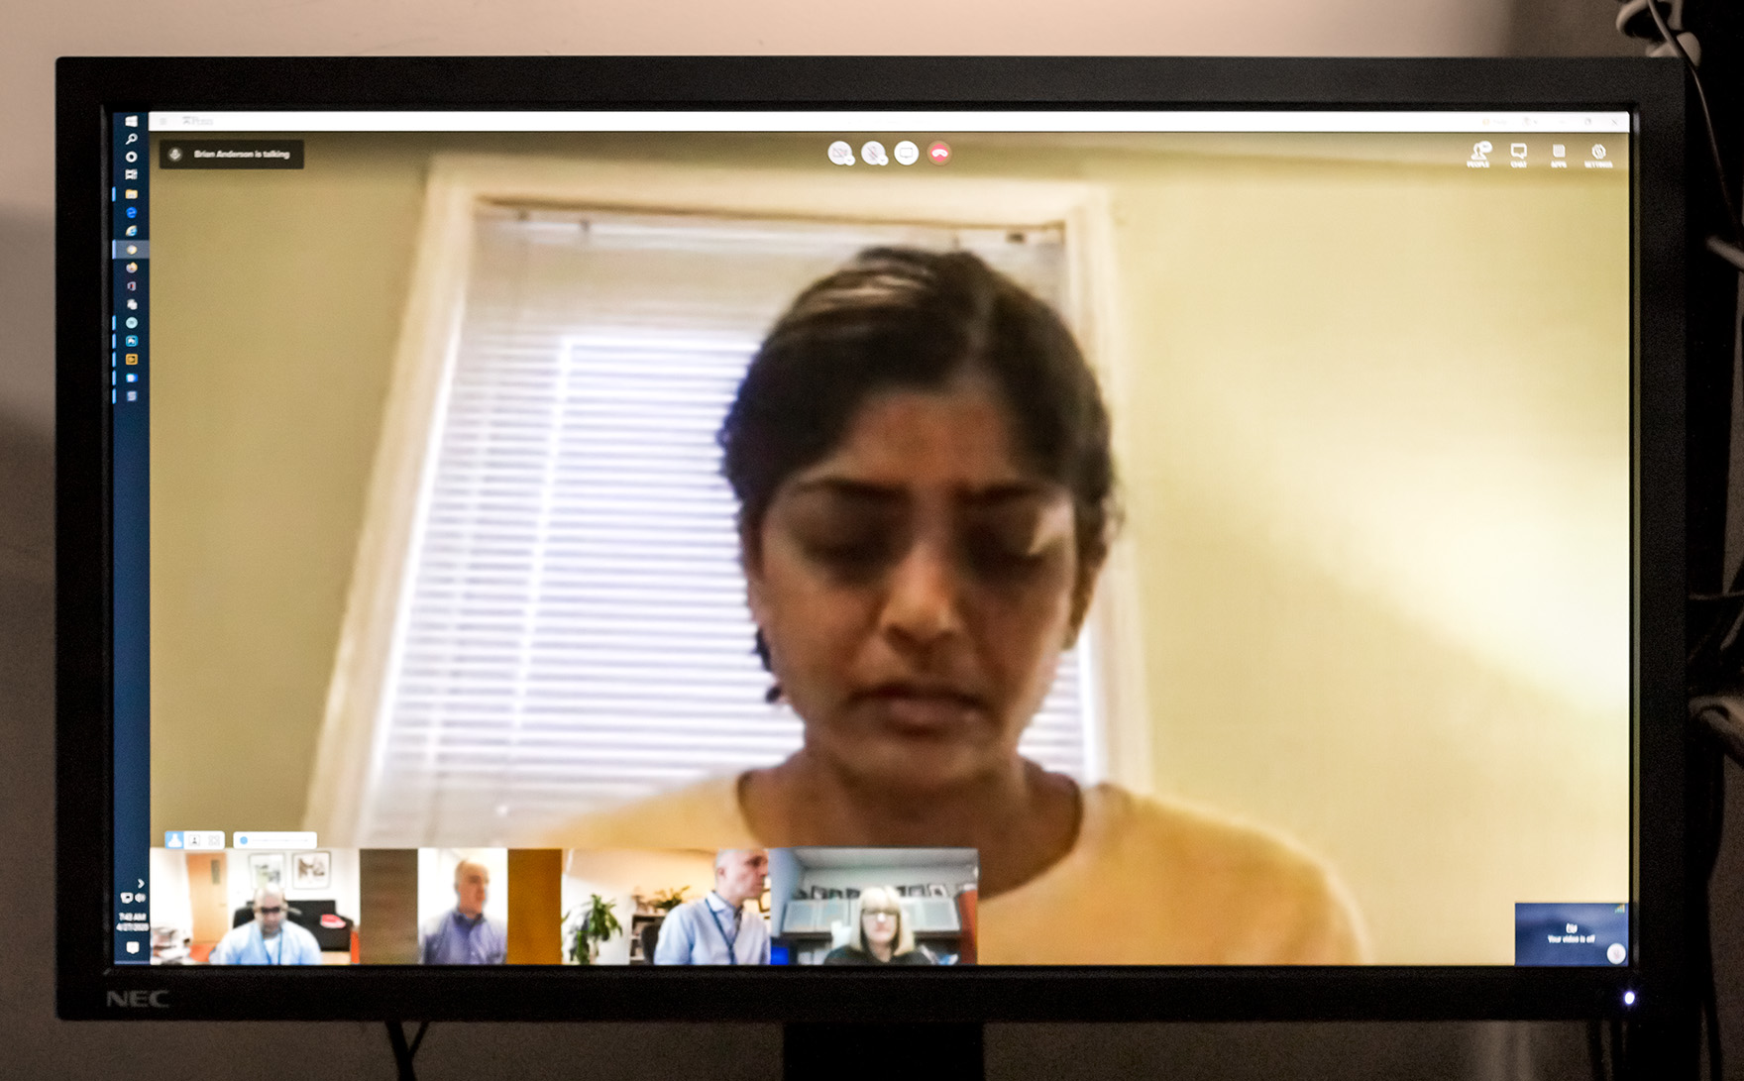
Meeta Kerlin
Co-leader, Division Committee for Faculty Wellness during the COVID-19 crisis
Medical Intensivist, Hospital of the University of Pennsylvania

Slide 25
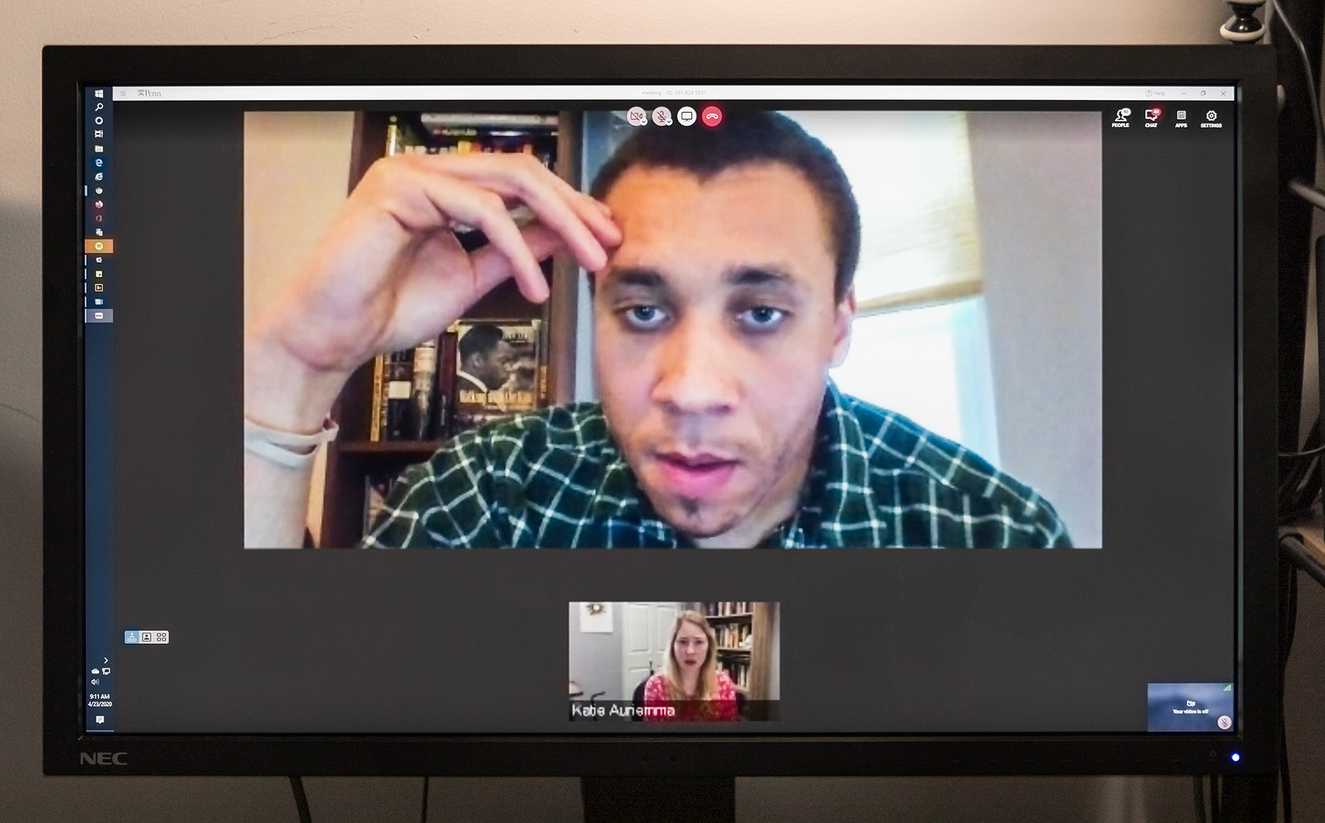
Christopher Chesley
Pulmonary and Critical Care Fellow

Slide 26
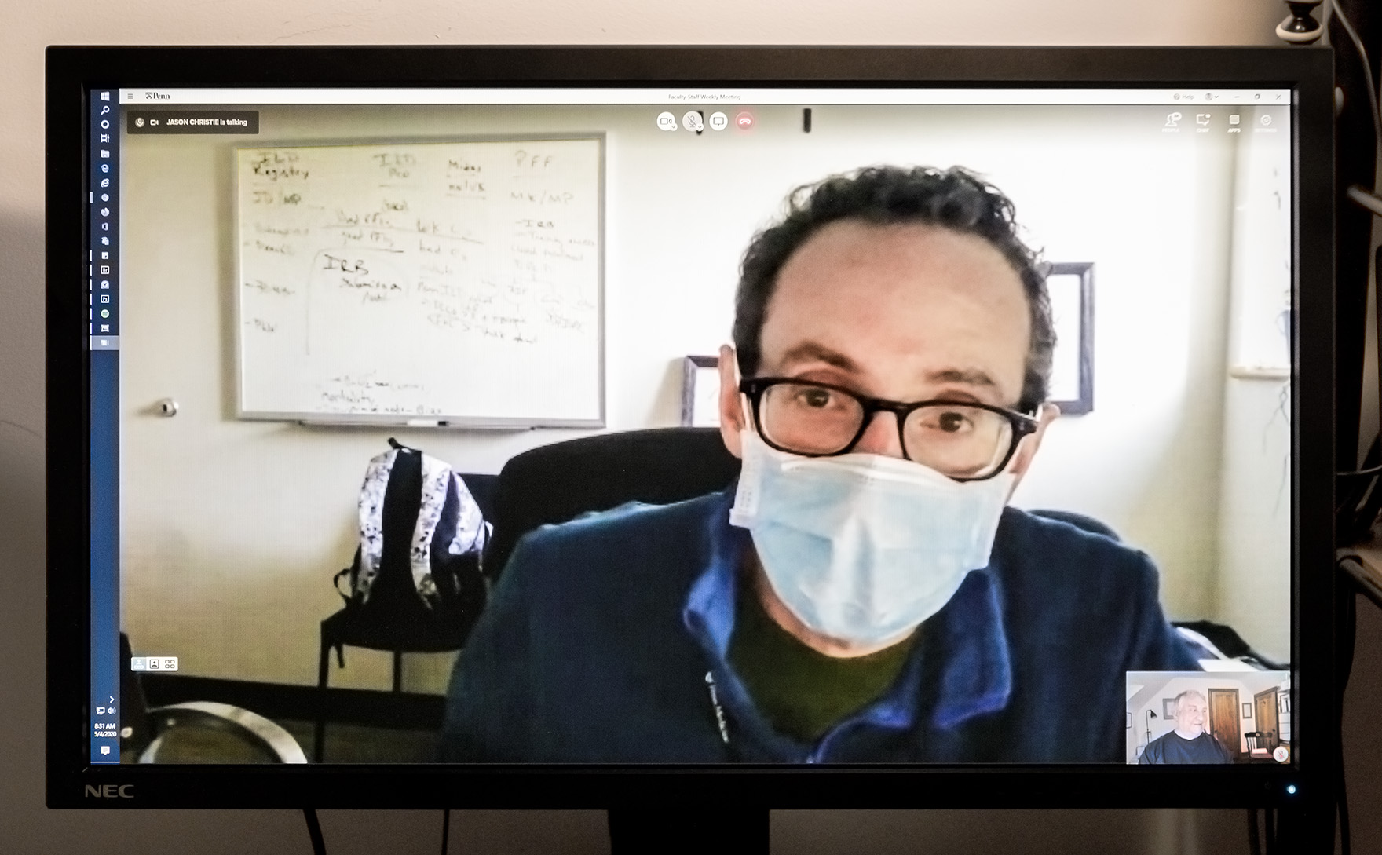
Joshua Diamond
Associate Medical Director, Lung Transplant Program
Medical intensivist, Hospital of the University of Pennsylvania

Slide 27
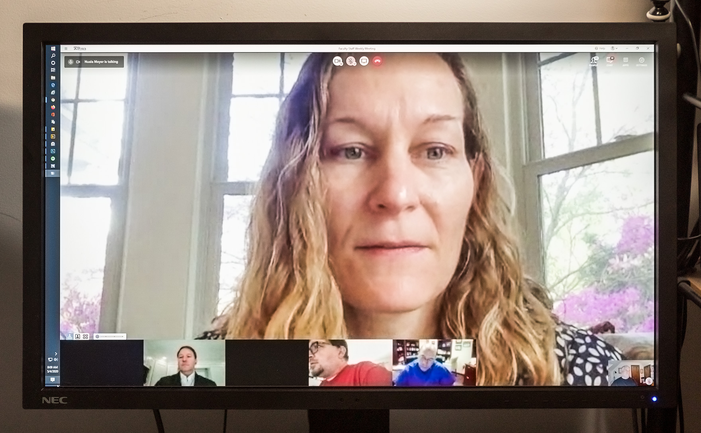
Nuala Meyer
Vice Chief for Research, Pulmonary, Allergy, and Critical Care Division
Medical intensivist, Hospital of the University of Pennsylvania

Slide 28
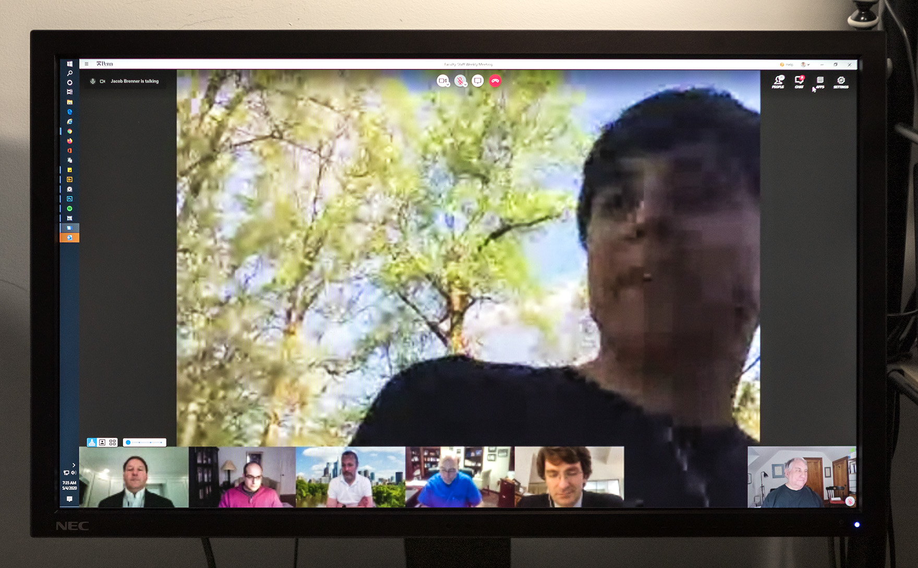
Jacob Brenner
Head, Ventilator Emergency Design and Manufacturing Group
Medical Intensivist, Hospital of the University of Pennsylvania

Slide 29
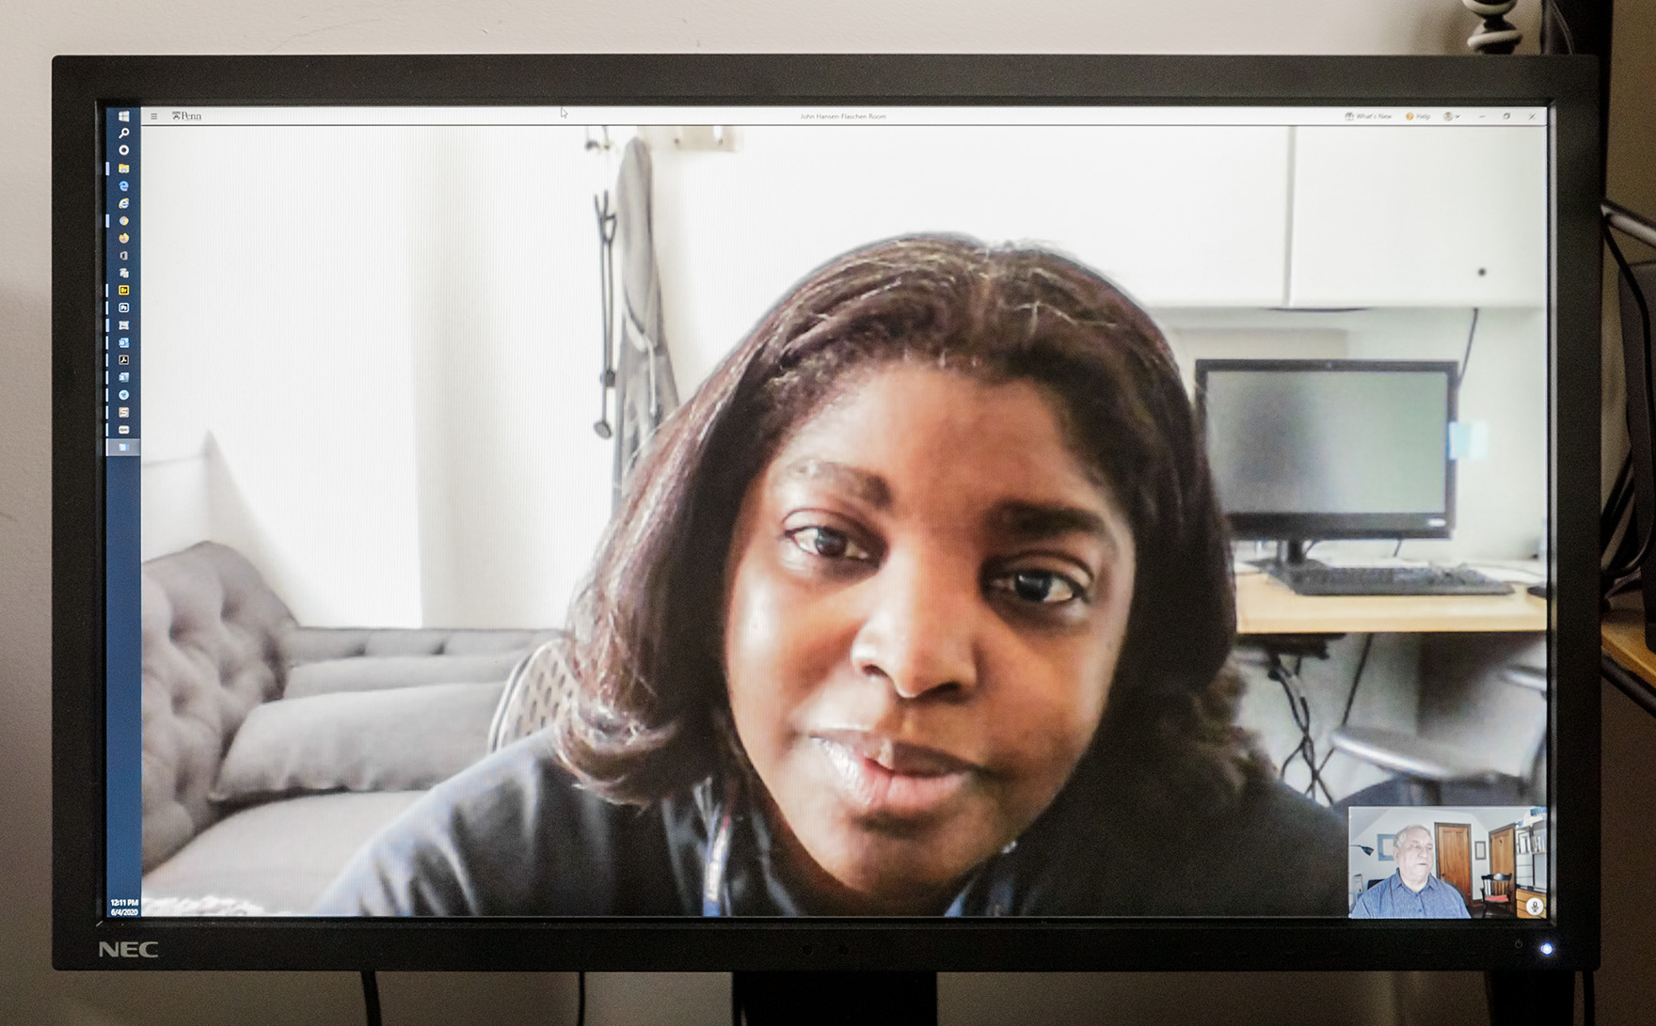
Kerri Akaya Smith
Medical Intensivist, Hospital of the University of Pennsylvania

Slide 30
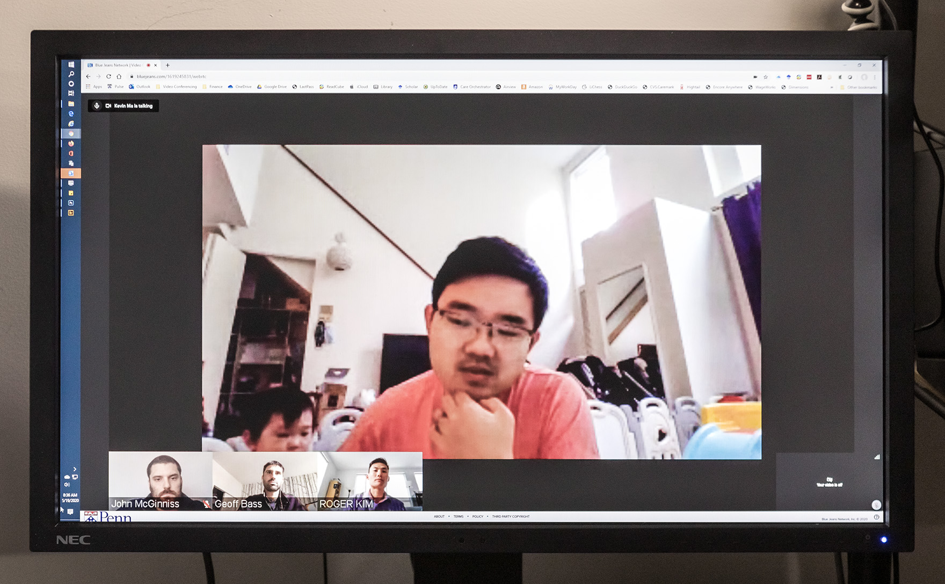
Kevin Ma with Zoe
Medical Director, Clinical Emergencies Task Force, Penn Presbyterian Medical Center
Medical Intensivist, Penn Presbyterian Medical Center

Slide 31
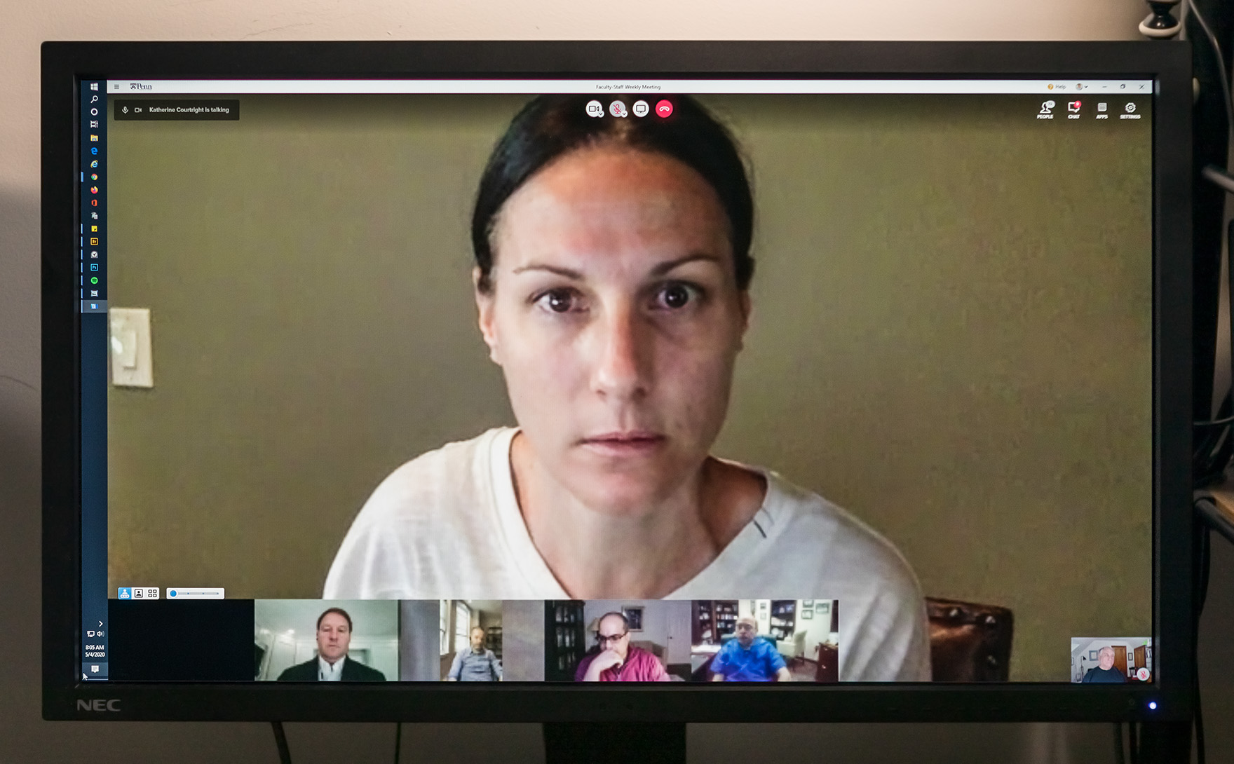
Katharine Courtright
Medical Intensivist, Hospital of the University of Pennsylvania

Slide 32
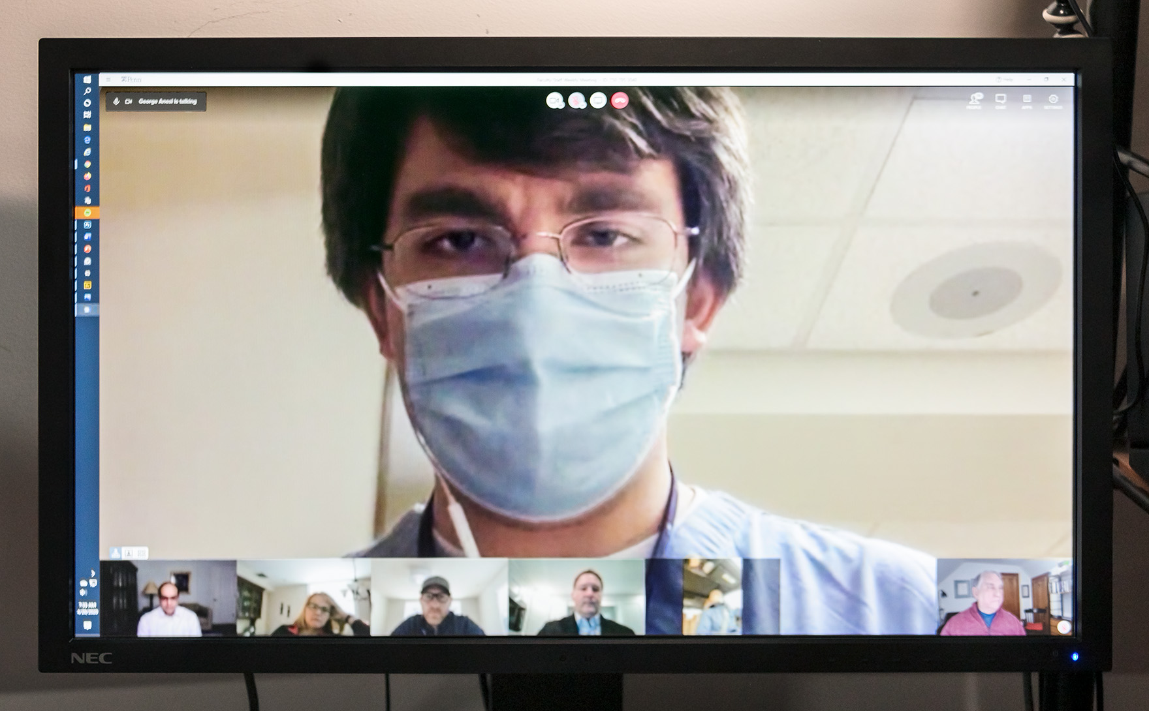
George Anesi
Chair, Penn Medicine Critical Care Alliance Pandemic Preparedness Committee
Medical Intensivist, Hospital of the University of Pennsylvania

Slide 33
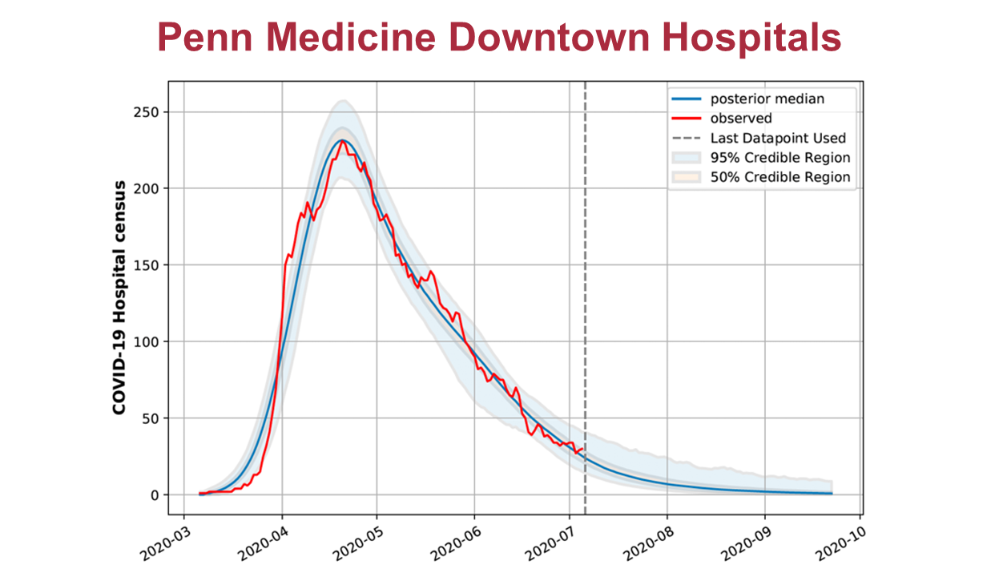
The first Philadelphia surge in COVID-19 hospital occupancy peaked in mid-April and subsided more slowly than it arose. More surges are anticipated.

