Slide 1
HOW SOCIOECONOMIC FACTORS IN THE BLACK COMMUNITY CONTRIBUTES TO HIGH COVID RATES
By: Rebecca Sainte, Brandon Hayles, Oliver Khoury, and Eimma Zuniga

Slide 2
Outline
Brandon Hayles: African Americans Lack of Access to Health Insurance
Brandon Hayles: Health Conditions in the African American Community Due to A Surplus of Fast Food in their Neighborhoods
Oliver Khoury: Covid-19 and The Call for Social Distancing
Oliver Khoury: Challenges To Social Distancing in African American and Low Income Neighborhoods
Oliver Khoury:Social Distancing Enforcement
Oliver Khoury: The Difference in Treatment By Law Enforcement
Oliver Khoury: How Social Distancing Has Impacted Communities
Rebecca Sainte: Living In Poverty and Being Essential Workers
Rebecca Sainte: African American Lost Wages, Unemployment and Delays in Aid
Rebecca Sainte:Blacks Struggle To Pay For Essentials During Pandemic
Eimma Zuniga: African American Men Have a Fear of Wearing Mask
Eimma Zuniga: Homemade Mask can Cause a Risk for Black Men
Eimma Zuniga: African American men Opted to Go to Local Store
Eimma Zuniga: Black Men Are Not Using Face Masks Due To Safety
Eimma Zuniga: African American Men Are still Attacked

Slide 3
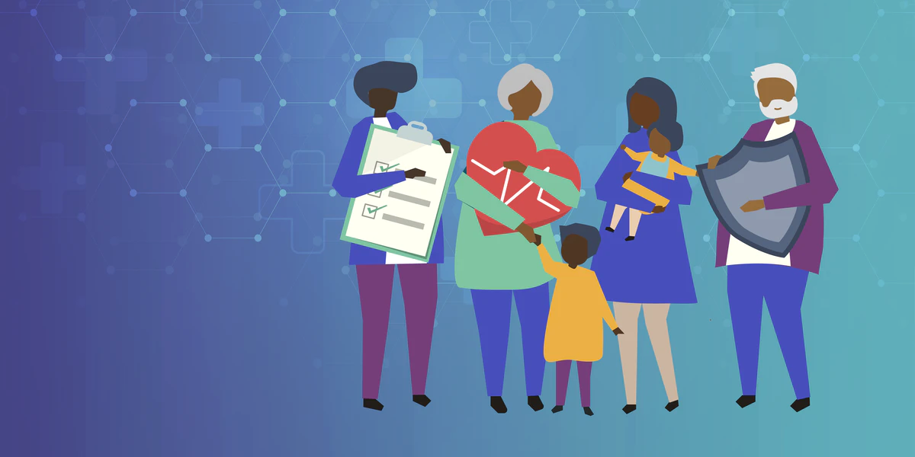
African Americans Lack of Access to Health Insurance
African Americans having less access to healthcare than other races, will lead to higher rates of the coronavirus in their communities.
The average cost of health care premiums for African Americans is approximately 20 percent of the average household income. This cost is almost unbearable to keep up with; especially since this is annual. I added this specific statistic in order to show how expensive health care is.
Up to 1 in 5 African Americans were uninsured,compared to approximately 1 in 8 white Americans.
Approximately 30 million people are still uninsured. About half of this 30 million are African American.

Slide 4
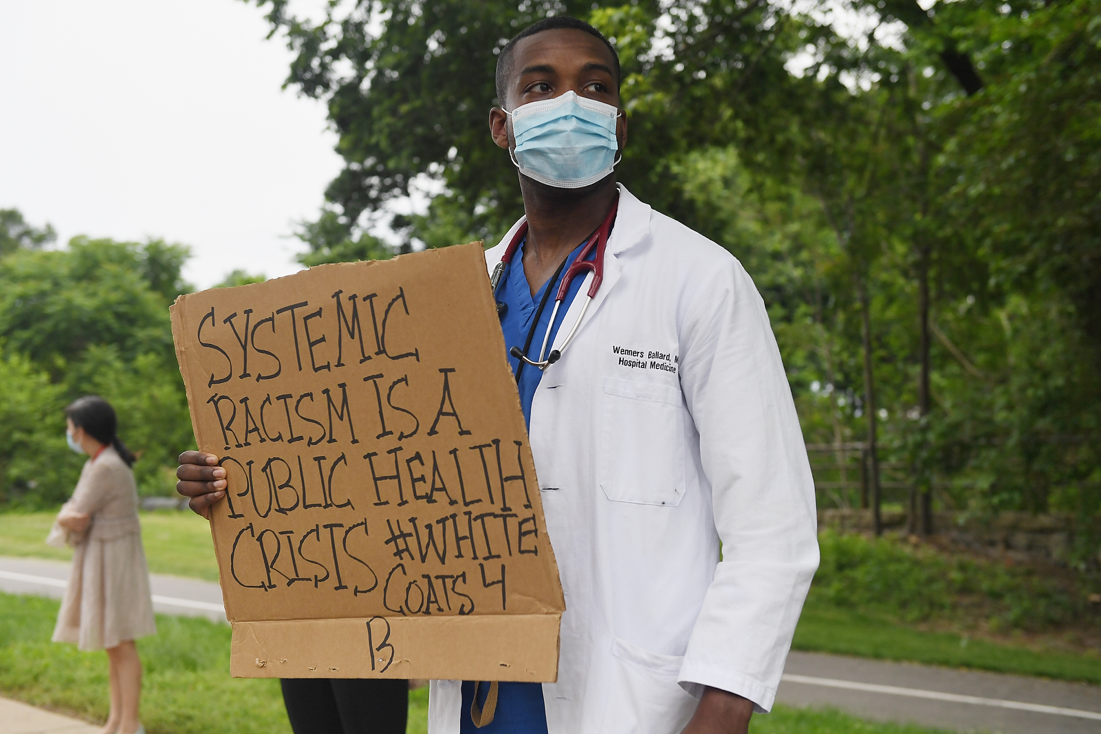
Another aspect I want to highlight in healthcare is the comparison of death between white and black pregnant mothers and children.
Based on data from 2016, the United States white babies die before their first birthday at a rate of 4.9 per 1,000, and white woman passes from pregnancy at a rate of 13 per 100,000.
African American women with child on the other hand, dies at a rate of 42.8 per 100,000. That is more than double or triple the rates of white mothers and their babies.
As of right now fourteen states refused to expand medicaid which is one of the reasons why African Americans are more likely to be uninsured, because majority of these states are heavily populated with African Americans.

Slide 5
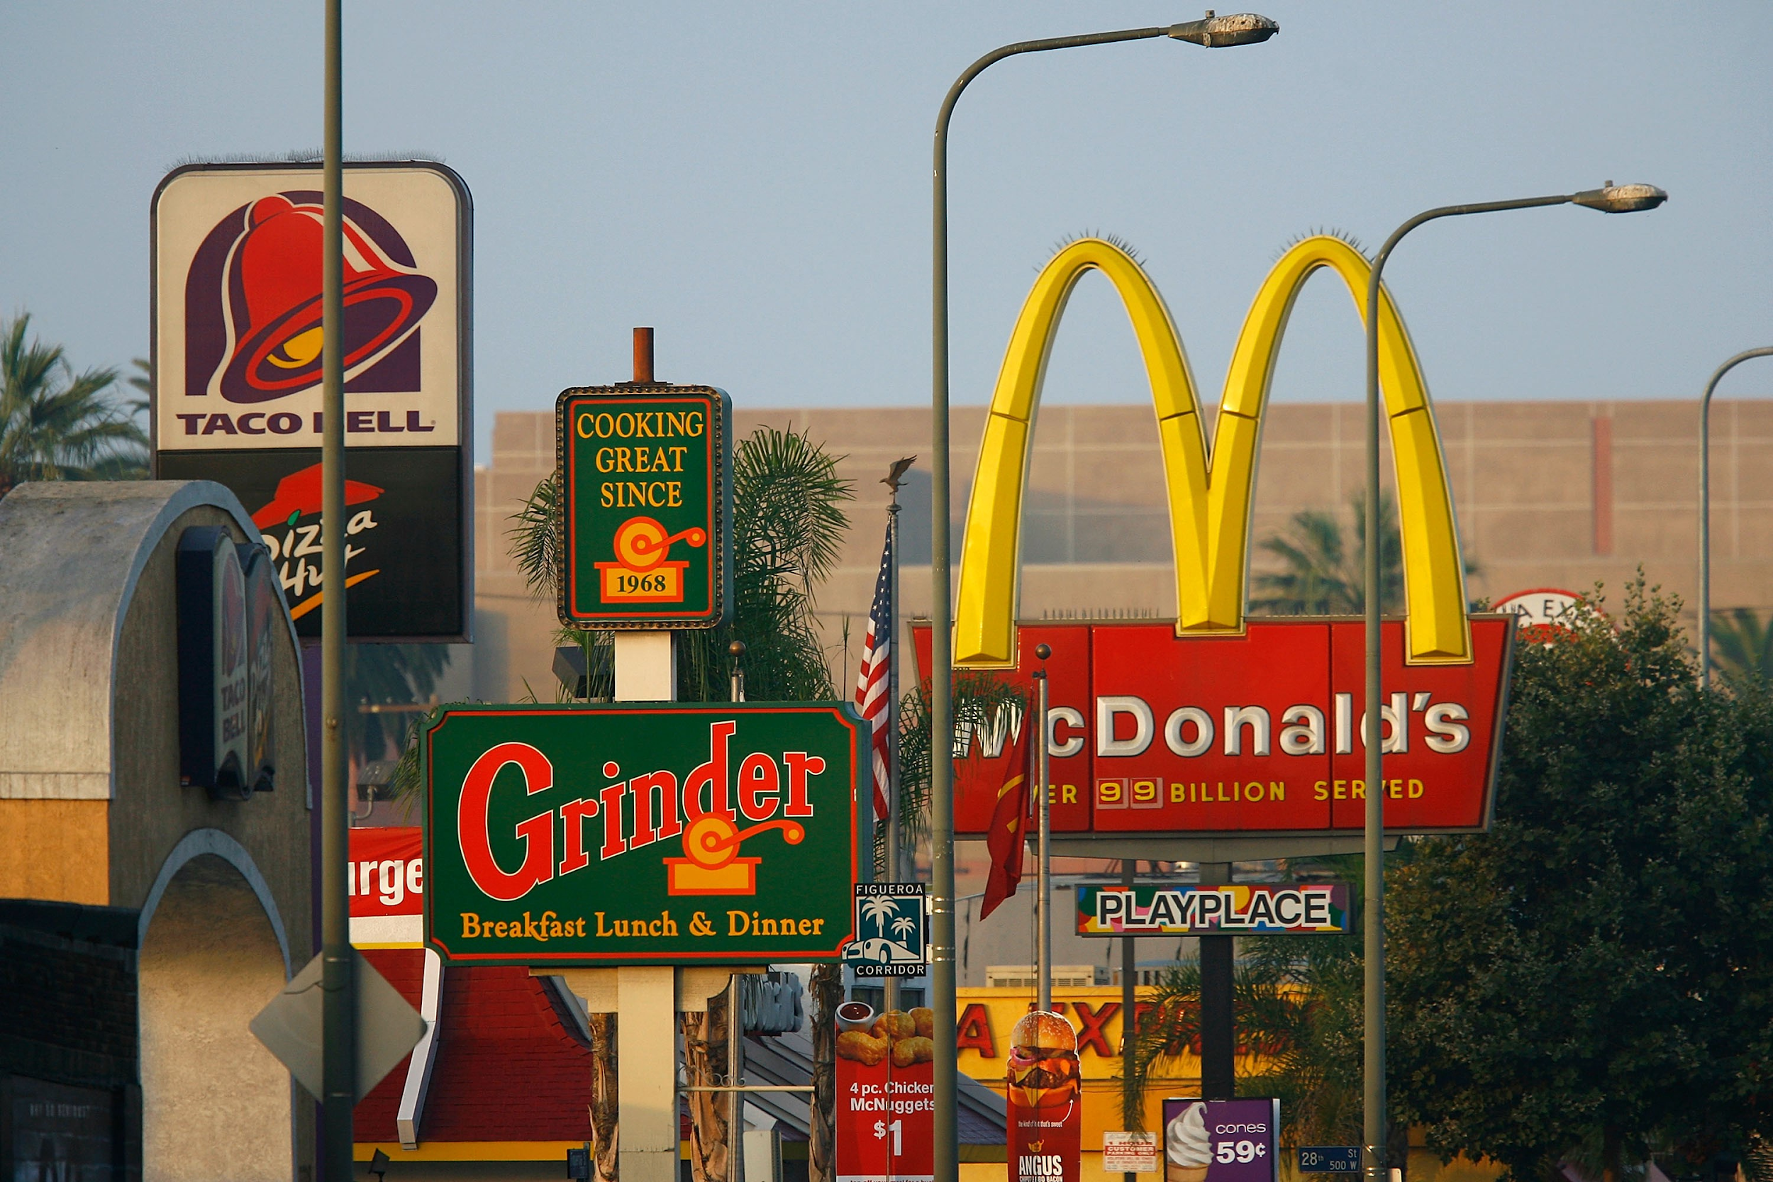
Health Conditions in the African American Community Due to A Surplus of Fast Food in their Neighborhoods
In most African American communities worldwide, are filled with cheap fast food restaurants. In order to eat healthy on a consistent basis takes a lot of work, consistency, dedication, and money. It is extremely difficult when there isn`t any healthy options in the community. Lack of ownership plays a major component as well.
Due to these unfortunate circumstances, it is documented that African Americans consume less vegetables and fruits than whites. This disparity can lead to a weaker immune system which increases the risk of the coronavirus, in the African American community. This can also lead to diabetes, heart diseases, etc. I want to further highlight this disparity occurs because of the unequal access to economic and social resources!

Slide 6
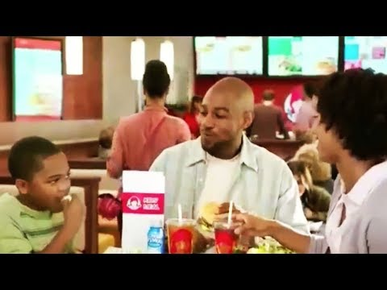
Lower income communities consist of various fast food restaurants. Unfortunately, African Americans reside in these urban communities.
According to the American Journal of Public Health, it indicates that lower income African Americans that resides in urban communities, has fast food restaurants that are approximately 2 miles apart.
African Americans has a higher rate of obesity. Mainly women, than other races; and the rate is significantly increasing.
According to the United States Department of Agriculture, from 2013 to 2014 African Americans over the age of 2 derived 20 percent of their food energy from fast food, compared with just 15 percent for whites and 16 percent for Hispanics.
In my opinion, I believe the executives of these fast food companies are specifically targeting African Americans. It isn`t just a coincidence like others believe.

Slide 7
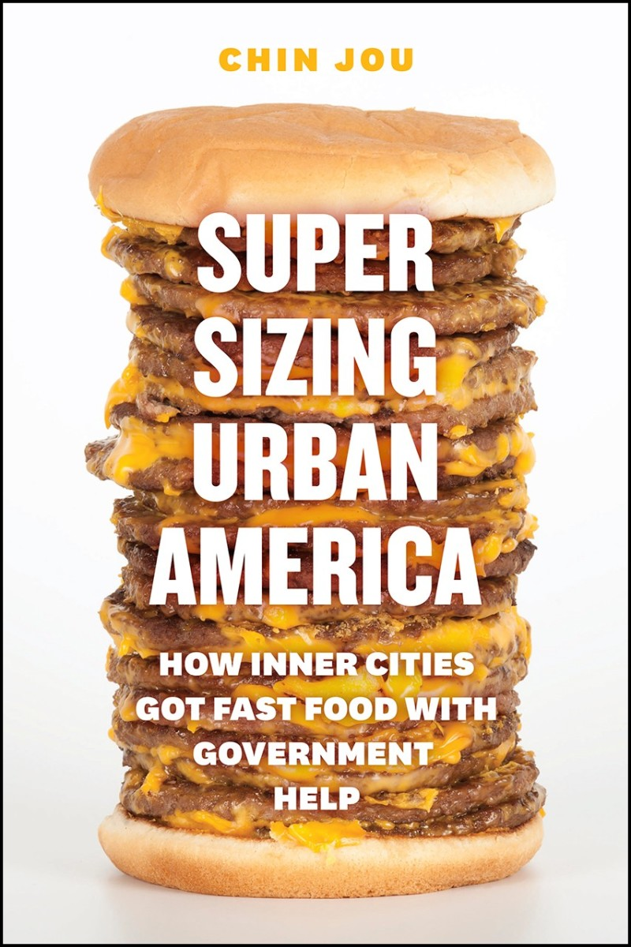
I also want to go back to the cause of this issue; which is a lack of ownership.
One reason for this is lower level access to financial and business assets.
Another reason is the access African Americans have to loans in order to start their own businesses in order for their communities to develop better food choices.
If an individual`s last name has an African American resemblance; then for the most part it`ll be difficult to receive a loan. This is only going to increase the difficulty of acquiring finances in order to start food businesses, or any establishments in general.
In conclusion, African Americans are selecting the best available option as a result to their neighborhood food sources.

Slide 8
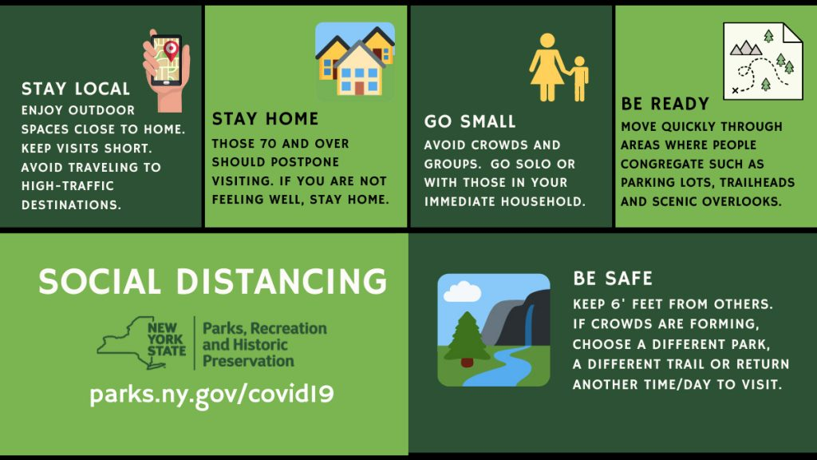
Covid-19 and The Call for Social Distancing
As Covid-19 continues to wreak havoc on the world, its effects have disproportionately been felt in African American communities, and low income neighborhoods across the country.
At an attempt to deal with the rapid spreading of the virus, the government began implementing new “social distancing” rules.
Social distancing rules include the wearing of masks when one is out in public, a designated limit of the number of people that can congregate in one area,the call for people to keep a distance of 6 feet between one another, and to work/remain at home whenever possible.
While in an ideal society it would be easy to follow these rules, some people simply do not have the means to.

Slide 9
Challenges To Social Distancing in African American and Low Income Neighborhoods
The first challenge to social distancing is the fact that many African Americans and poor people of color in the United States work jobs that the government considers to be “essential”. In other words these are people who despite calls to work from home still have to show up for work and risk contracting the virus.
A few examples of essential workers are, supermarket employees, transit workers, and maintenance workers.
Another challenge to social distancing is the fact that many African American and low income neighborhoods in the United States are far more populated and dense than those populated by whites and the rich.
Making it extremely difficult to keep one's distance when walking in the street or shopping at a supermarket for example.
A third challenge to social distancing is that many African Americans and people of color commuting to work, the doctors, or any other area rely on public transportation to get them there.
Public transportation, especially in New York are the exact opposite of social distance friendly areas.

Slide 10
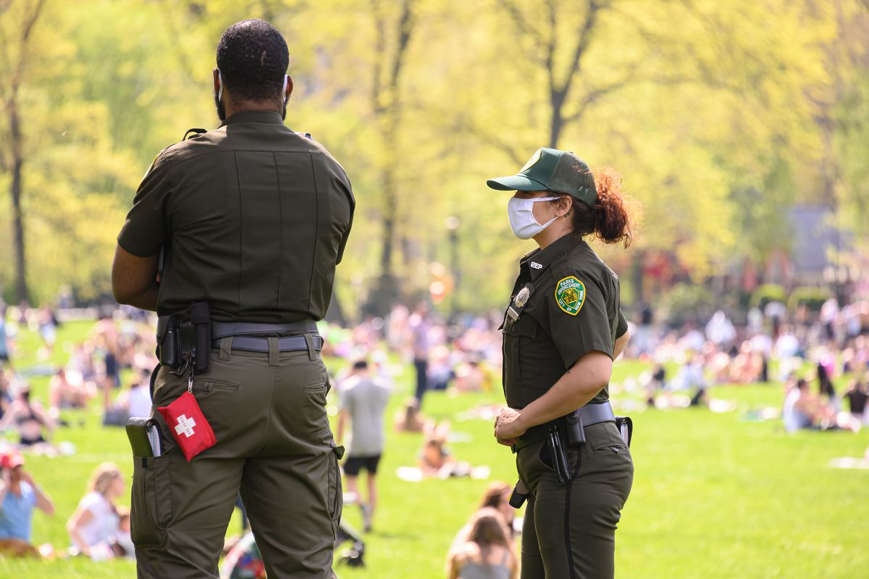
Social Distancing Enforcement
As discussed in the previous slide, low income people of color do not have the privilege to practice social distancing to its full extent. On top of putting them at risk of contracting the virus, they are also subject to unjust policing.
According to NYPD reports, 65% of people arrested for disobeying social distancing rules have been black, and 24% have been Hispanic.
This is proof that law enforcement unfairly target minorities when it comes to social distancing, even if these individuals cannot abide to these rules. Yet another form of systemic racism here in the United States.
When addressing these statistics, Mayor de Blasio said “We do not accept disparity, period.” However these numbers would say otherwise.

Slide 11
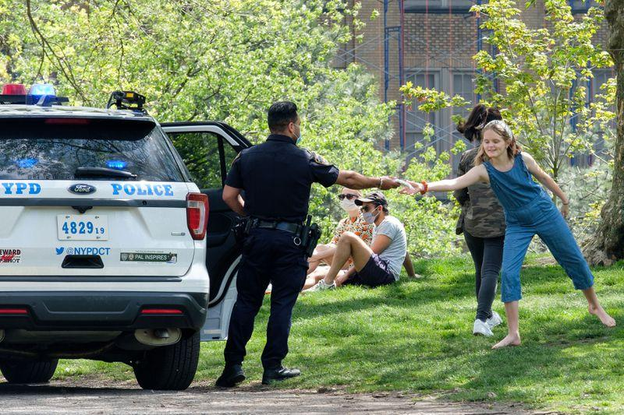
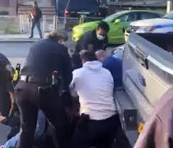
The Difference in Treatment By Law Enforcement
Since the start of the pandemic, there have been many documented cases of the different ways police have dealt with people failing to practice social distancing rules.
In white areas/communities during the summer for example, it was common to see hundreds of people gathered at parks in large groups without masks.
The police would then proceed to hand out masks and ask these individuals to kindly put them on
In African American communities however it was a drastically different images, there were many instances where police used violence in order to deal with anyone disobeying social distancing rules
The second image for example is from a video where police used violence to arrest a man who was not following social distancing rules

Slide 12
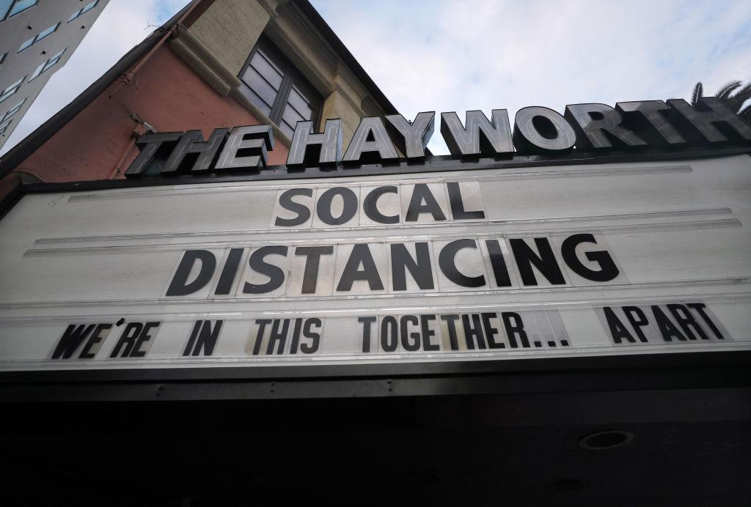
How Social Distancing Has Impacted Communities
As we are constantly being told to keep our distance from everyone outside of our immediate family, social ties within these close knit communities have been adversely affected.
Students have lost the ability to interact with their classmates and teachers, grandparents have been separated from their families( as those who are 70 and up are considered to be in the highest risk group) neighbors now have to keep their distance from one another, and workers are now forced to work in isolation.
It has also been reported that the loss of human interaction and extended self isolation are extremely detrimental to mental health.

Slide 13
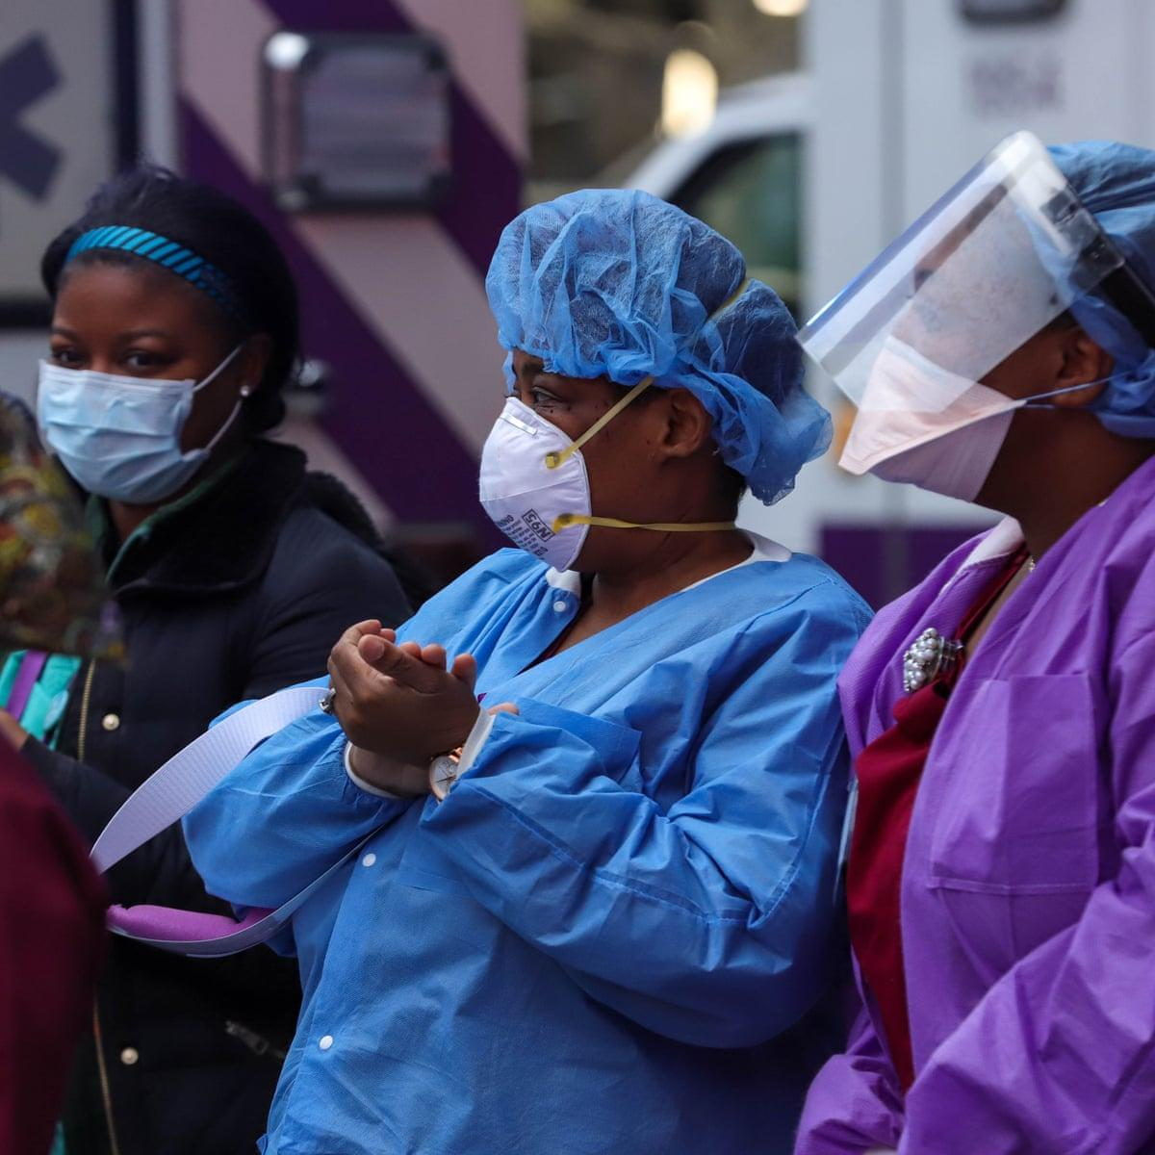
LIVING IN POVERTY AND BEING AN ESSENTIAL WORKER
The socioeconomic discrimination has confined African Americans to overpopulated housing estates (ghettos) and low-wage jobs.
African Americans have always been the essential or sacrificial workers used to ensure the continuity of this economy.
A large number of African Americans work in retail, home healthcare, mass transit, plant factories, and prisons/jails where social distancing is almost impossible. As a result, African Americans became more vulnerable to the disease combined with inadequate access to proper healthcare in their communities

Slide 14
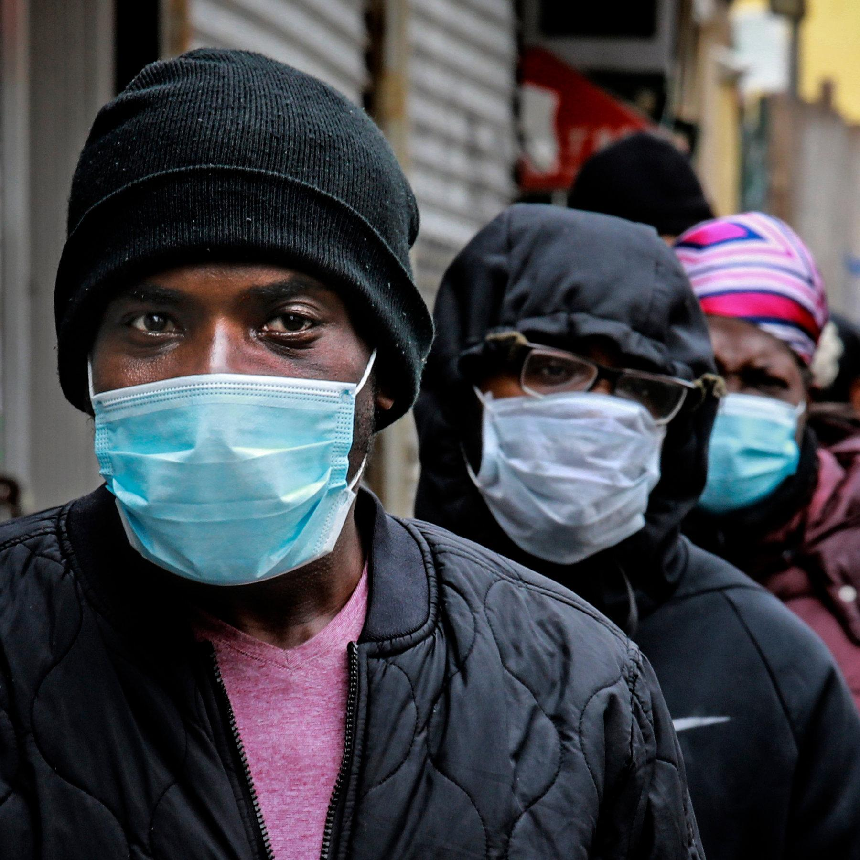
LIVING IN POVERTY AND BEING AN ESSENTIAL WORKER Cont….
The 2010 US Census revealed that 15.1% of Americans live in poverty (defined by a household income of $22,314 for a family of 4).
African Americans have the highest poverty rate among racial/ethnic groups (27.4%), with lower median incomes for rural than urban African American households
Many African Americans reside in small and/or multi-generational homes with extended families, use public transportation to commute to jobs and other places, and many of them are “essential” workers (like janitors and delivery workers), which means face-to-face contact with many people (often without adequate personal protective equipment). This makes social distancing and self- isolation virtually impossible, and it increases the risk of exposure

Slide 15
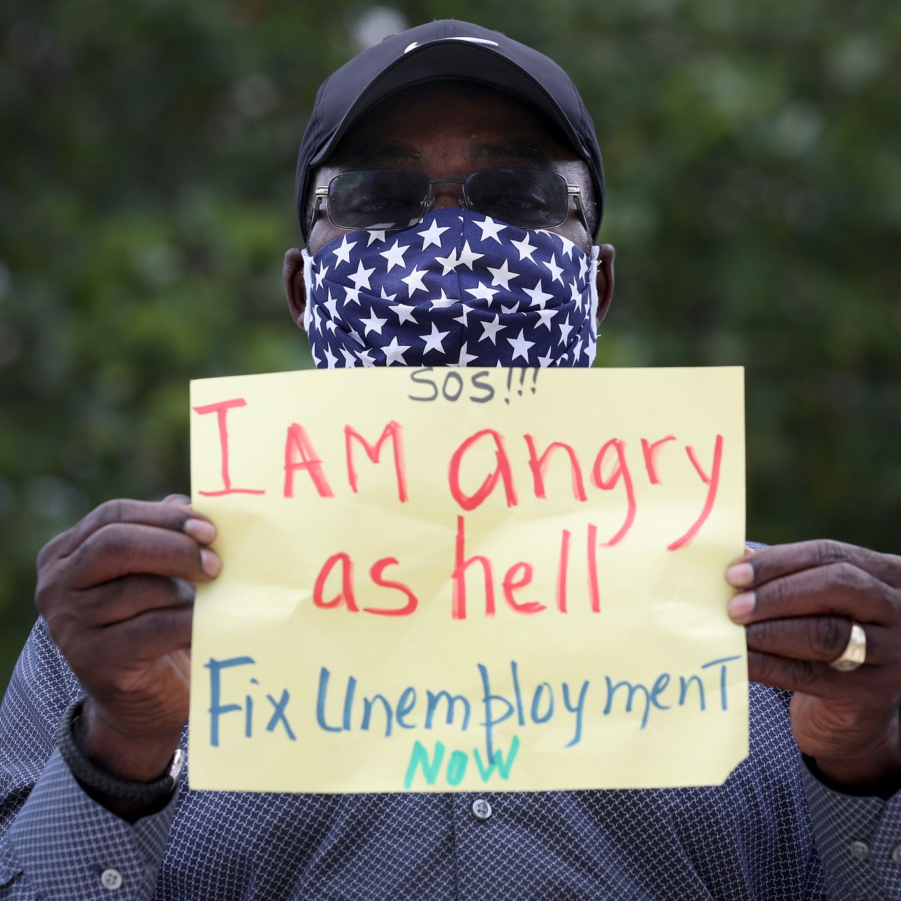
African American Lost Wage Unemployment—And Delays in Aid
In the article entitled Covid And Race: Households Of Color Suffer Most From Pandemic’s Financial Consequences Despite Trillions In Aid by Kelly Anne Smith states:
Four in 10 Latino and Black households and half of Native American households have had their wages or hours reduced, are furloughed and have lost their jobs entirely.
(17%) of black households have already fallen behind on their payments
Black Americans receive lower earnings than their white counterparts; Black workers made 14.9% less than their white counterparts in 2019, according to the Economic Policy Institute’s (EPI) wage report. The report also found that Black and Latino workers are paid less at almost every education level, compared to their white counterparts.

Slide 16
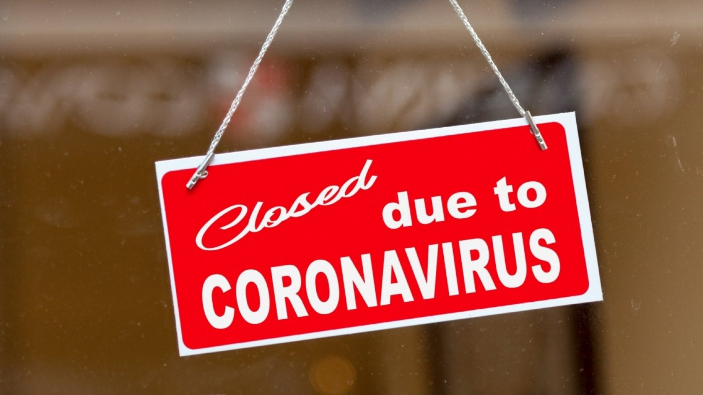
Blacks Struggle To Pay For Essentials During Pandemic
The article entitled How The Pandemic Is Widening The Racial Wealth Gap by Rhitu ChatterJee recorded the economic crisis of various minority groups. Here are the findings for African Americans:
28% of Black reported they're having problems paying rent or mortgages.
22% of Black reported they are struggling to afford food
60% of blacks report serious financial problems
41% of blacks report using all or most of their savings
31% of blacks report having serious problems paying credit cards/loans/debt
18% of blacks report having serious problems affording medical care
21% of blacks report having serious problems making car payment
17% reported other serious financial problems

Slide 17
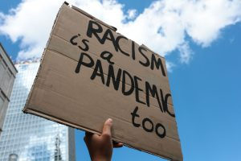
Dealing With Systematic Racism and a Pandemic
In the article entitled During this pandemic, racism is our most urgent public health emergency by Melanie Ferris states the different societal groups that discriminate against african americans
Criminal justice: A recent study estimated that 1 in 1,000 Black men will be killed by police, a rate 2.5 times greater than for white men.
Black Americans are “more likely than white Americans to be arrested; once arrested, they are more likely to be convicted; and once convicted, and they are more likely to experience lengthy prison sentences.
Housing and homeownership: Past policies, including redlining, racial covenants and discriminatory zoning, denied people of color the same opportunities to generate wealth as white homeowners and led to racially segregated neighborhoods
Chronic disinvestment in these neighborhoods leads to fewer employment opportunities, poorer housing quality, greater likelihood of exposure to environmental pollutants, and less access to resources that support health and well-being.
Health care Multiple studies have shown that when treating Black patients, providers spend less time with patients, misinterpret or dismiss complaints, and undertreat pain, as compared with treatment for white patient

Slide 18
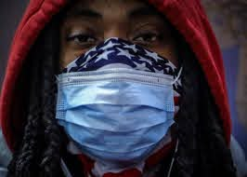
African American Men Have a Fear of Wearing Mask
During the beginning of the pandemic African American men had a fear of wearing mask because they felt that they would be harassed and racially profiled by police.
African American decided to change how they usually dress because of how they are stereotyped.
In the state of Illinois two black men wearing masks recorded themselves being harassed by police in a Walmart.

Slide 19
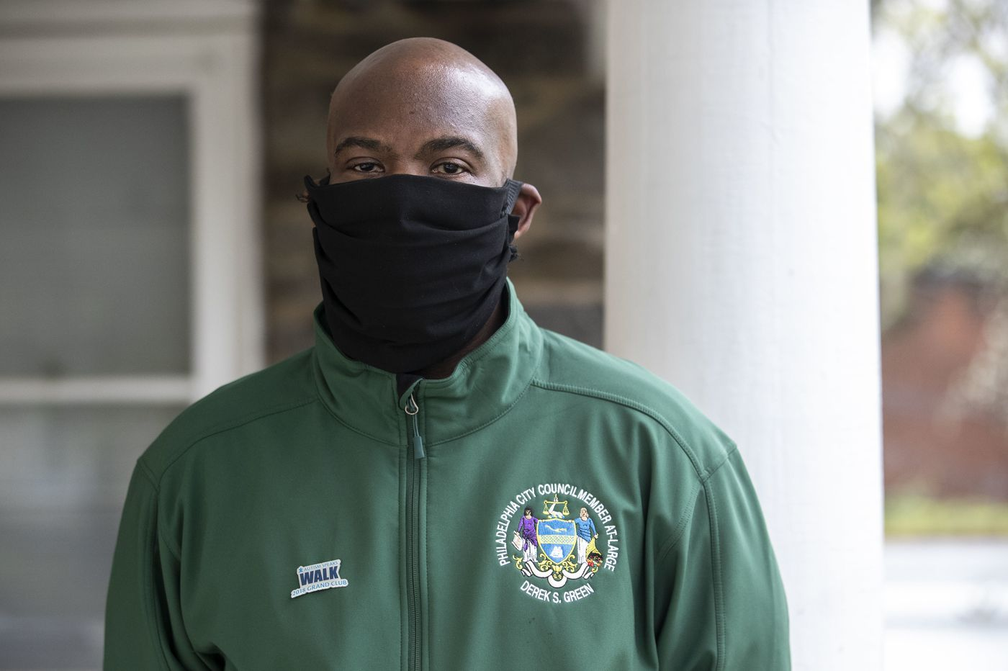
Homemade Mask Can Cause a Risk for Black Men
According to Alejandro De La Garza in, ‘It Conjures Up Every Racial Stereotype. ‘For Black Men, Homemade Masks May Be a Risk All Their Own, For Time.com
“A handful of recent encounters between black men and law enforcement around the country have underscored the fraught racial politics of mask-wearing”.
“But for people to use a bandana, it invites racial profiling. It conjures up every racial stereotype that we have to fight against when it comes to African American men and Latino men”, said Marc Morial, President of the National Urban League and former mayor of New Orleans.

Slide 20
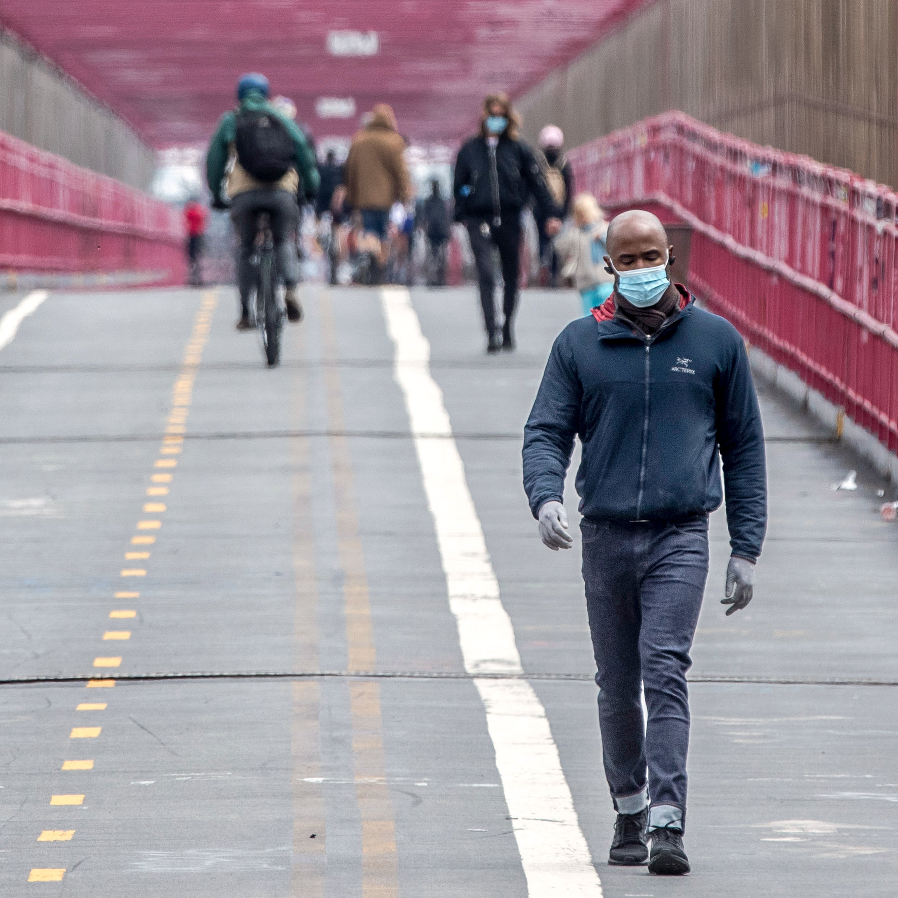
American American Men Opted to Go to Local Store
African American men decided to only go to local stores that they are already known or recognized by the owners or workers to avoid being harassed in stores for wearing masks and being seen as thieves.
They have also had talks with their families about only going to local stores that they usually go to as a safety precaution.

Slide 21
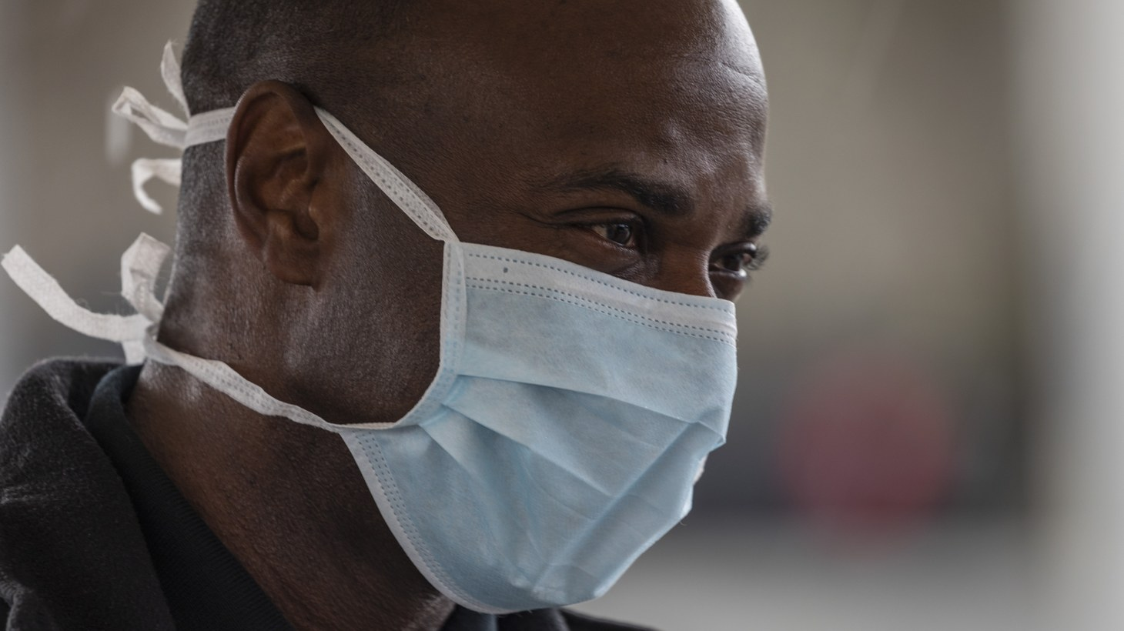
Black Men Are Not Using Face Masks Due to Safety
According to Billie Jean Shaw in, “For The Culture: Black Men are risking their health to avoid racial profiling”. For WCNC Charlotte.com
“The video showing a black jogger being chased and killed by two white men in Brunswick, Georgia has stunned the nation”.
Situation like the one that happend to 25 year old Ahmaud Aubrey's and many others are one of the reasons black men are not using maks and risking their health being exposed to Covid-19.

Slide 22
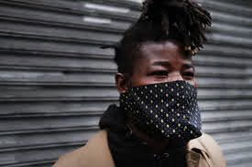
African American Men Are Still Attacked
In the summertime of May 2020 in New York City a video went viral of a NYPD trying to arrest a man by slapping and putting his knees on the man's neck because he did not have a mask on.
The incident was very controversial because it happened months after the death of George Floyd and during a time the country had many protest for the killings of unarmed black men and police brutality.
People compared how black people/men were harassed/arrested for not wearing masks to white people who were also not wearing masks but did not have the same fate as black people/men.

Slide 23
Citations
DeLuca, S. (2020). The Unequal Cost of Social Distancing. Retrieved December 07, 2020, from https://coronavirus.jhu.edu/from-our-experts/the-unequal-cost-of-social-distancing
Southall, A. (2020, May 07). Scrutiny of Social-Distance Policing as 35 of 40 Arrested Are Black. Retrieved December 07, 2020, from https://www.nytimes.com/2020/05/07/nyregion/nypd-social-distancing-race-coronavirus.html
Henry-Nickie, M., & Hudak, J. (2020, May 20). Social distancing in Black and white neighborhoods in Detroit: A data-driven look at vulnerable communities. Retrieved December 07, 2020, from https://www.brookings.edu/blog/fixgov/2020/05/19/social-distancing-in-black-and-white-neighborhoods-in-detroit-a-data-driven-look-at-vulnerable-communities/
Chatterjee, R. (2020, September 18). How The Pandemic Is Widening The Racial Wealth Gap. Retrieved December 07, 2020, from https://www.npr.org/sections/health-shots/2020/09/18/912731744/how-the-pandemic-is-widening-the-racial-wealth-gap
Smith, K. (2020, September 18). Covid And Race: Households Of Color Suffer Most From Pandemic's Financial Consequences Despite Trillions In Aid. Retrieved December 07, 2020, from https://www.forbes.com/advisor/personal-finance/covid-and-race-households-of-color-suffer-biggest-pandemic-consequences/
Perry, S., & Writer, M. (2020, June 26). During this pandemic, racism is our most urgent public health emergency. Retrieved December 07, 2020, from https://www.minnpost.com/community-voices/2020/06/during-this-pandemic-racism-is-our-most-urgent-public-health-emergency/
Taylor, J. (2020, May 7). Racism, Inequality, and Health Care for African Americans. The Century Foundation. https://tcf.org/content/report/racism-inequality-health-care-african-americans/?agreed=1

Slide 24
Citations
Garza, A. D. (2020, April 16). 'It Conjures Up Every Racial Stereotype.' For Black Men, Homemade Masks May Be a Risk All Their Own. Retrieved from Time.com: https://time.com/5821250/homemask-masks-racial-stereotypes/
Shaw, B. J. (2020, May 15 ). For The Culture: Black men are risking their health to avoid racial profiling. Retrieved from WCNC.com: https://www.wcnc.com/article/news/community/for-the-culture/for-the-culture-black-men-are-risking-their-health-to-avoid-racial-profiling/275-224aa966-50cd-46ad-b8b2-33bae329808d
Rabin, R. C. (2019, May 7). Huge Racial Disparities Found in Deaths Linked to Pregnancy. The New York Times. https://www.nytimes.com/2019/05/07/health/pregnancy-deaths-.html
Park, A. (2018, June 11). How the fast-food industry courted African American customers. Washington Post. https://www.washingtonpost.com/news/made-by-history/wp/2018/06/11/the-origins-of-fast-foods-enduring-popularity-with-african-americans/
https://www.washingtonpost.com/news/made-by-history/wp/2018/06/11/the-origins-of-fast-foods-enduring-popularity-with-african-americans/

